Slide 1
Building the Practice of Servant Leadership
Karol A.D. Johansen, EdD
Notes:
I changed the first slide to add “proposal”

Slide 2
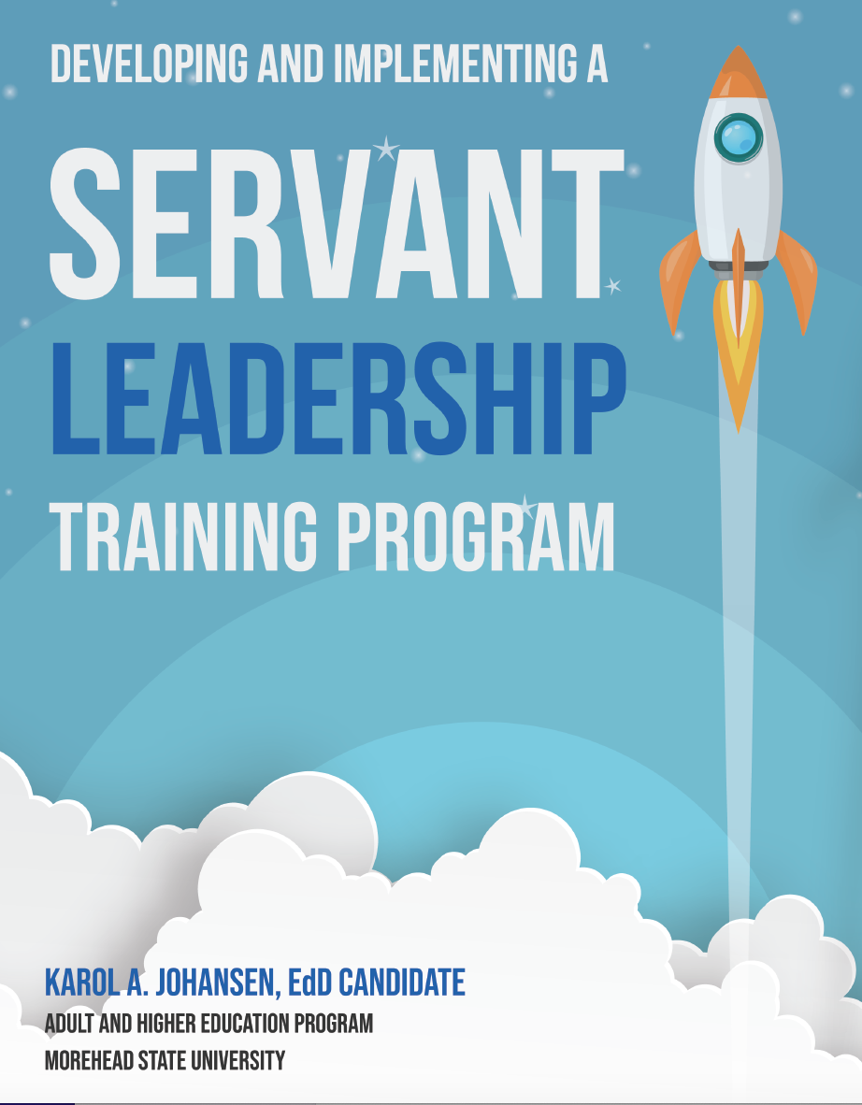

Slide 3
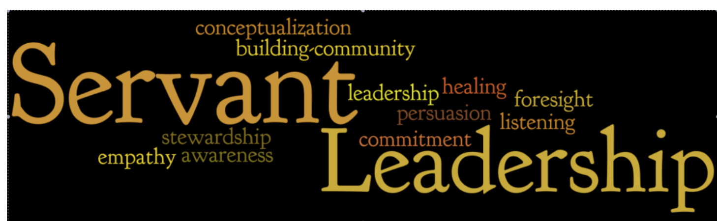

Slide 4
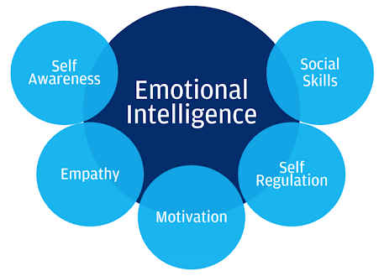
Servant Leadership and Emotional Intelligence
Roark and Beuthin (2014) have established a predictive relationship between emotional intelligence and servant-leadership. Emotional intelligence helps leaders recognize and interpret emotional information about themselves and those they lead.

Slide 5
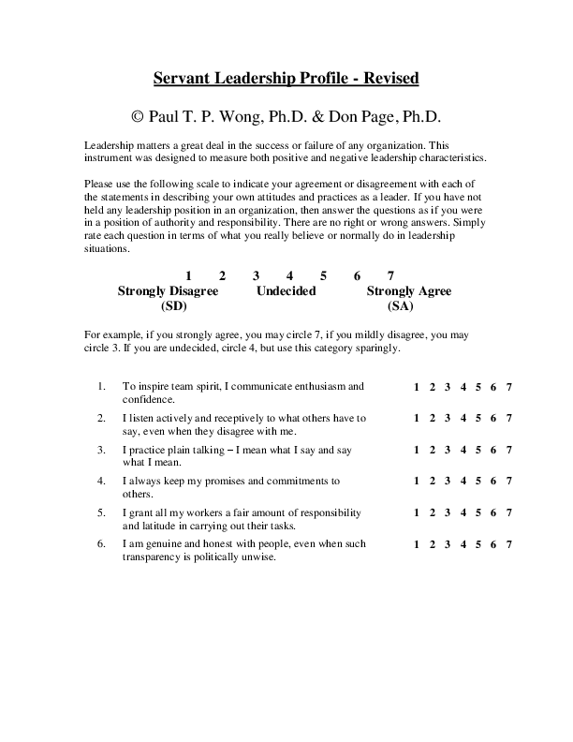
Servant Leadership Profile Revised Instrument (SLP-R): Self-Assessment for Leaders
The Servant Leadership Profile Revised Instrument (SLP-R), a 62 question survey developed from the research of Wong and Page (2003).
The SLP-R contains statements capturing the following factors: empowering and developing people; vulnerability and humility; serving others; open, participatory leadership; inspiring leadership; visionary leadership; and courageous leadership (integrity and authenticity). These factors align with van Dierendonck’s (2011) six core features of servant leaders. (Fields, 2015, p. 96).

Slide 6
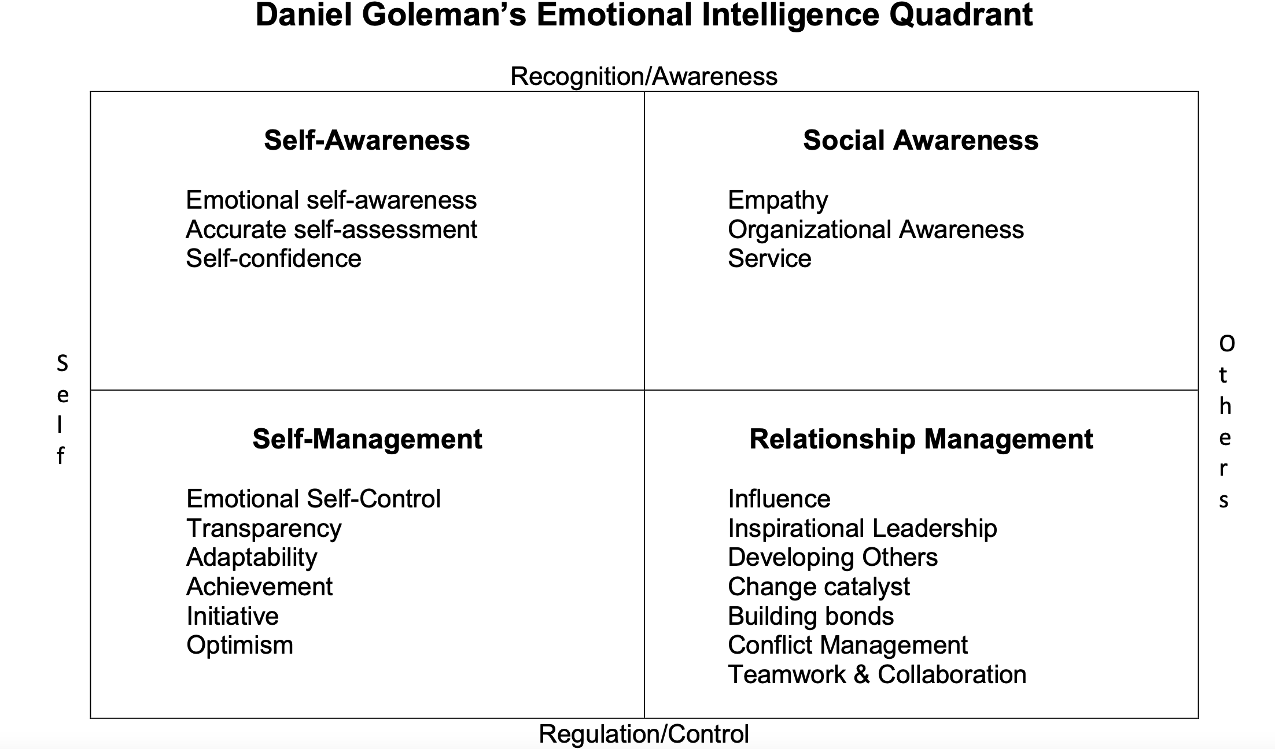
Goleman, D. (1998). Working with emotional intelligence. New York: Bantam Books.
Goleman, D., Boyatzis, R. & McKee, A. (2002). Primal Leadership: Realizing the Importance of Emotional Intelligence, Harvard Business School Press: Boston.
Hughes, M. & Terrell, J.B. (2007). The Emotionally Intelligent Team. San Francisco: Jossey-Bass.

Slide 7
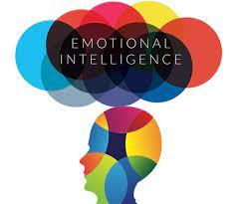
Definition: Emotional Intelligence
Emotional intelligence is defined as the ability to understand and manage your own emotions, as well as recognize and influence the emotions of those around you. The term was first coined in 1990 by researchers John Mayer and Peter Salovey, but was later popularized by psychologist Daniel Goleman. (Landry, 2019).

Slide 8
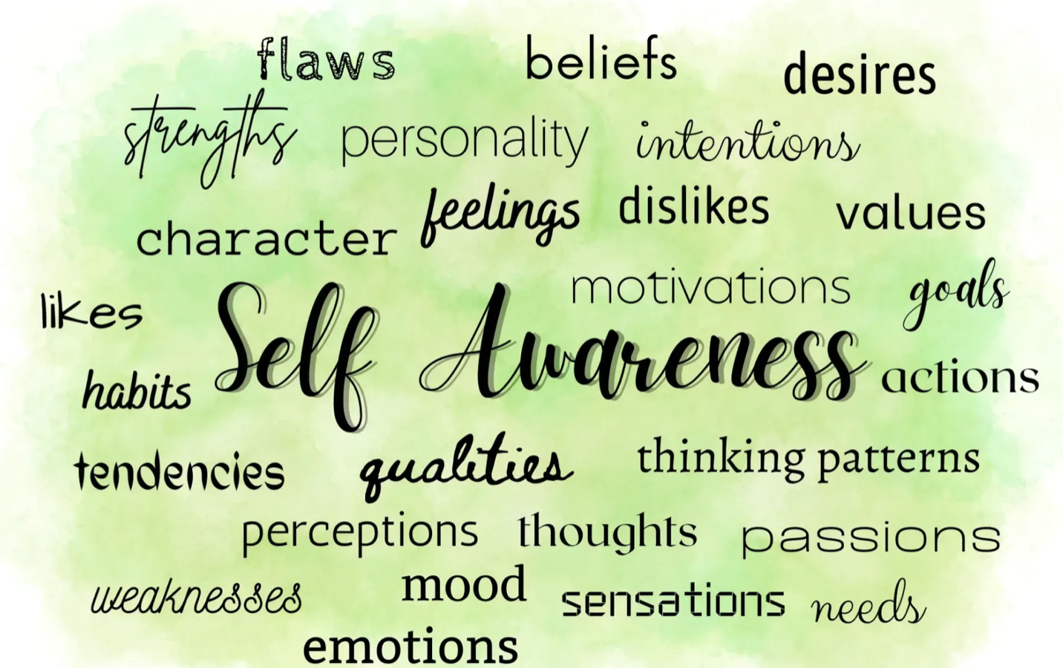
Self-Awareness
Self-awareness is at the core of everything. It describes your ability to not only understand your strengths and weaknesses, but to recognize your emotions and the effect they have on you and your team’s performance.
According to research by organizational psychologist Tasha Eurich, 95 percent of people think they’re self-aware, but only 10 to 15 percent actually are, and that can pose problems for your employees. Working with colleagues who aren’t self-aware can cut a team's success in half and, according to Eurich’s research, lead to increased stress and decreased motivation. (Landry, 2019, para. 3).

Slide 9
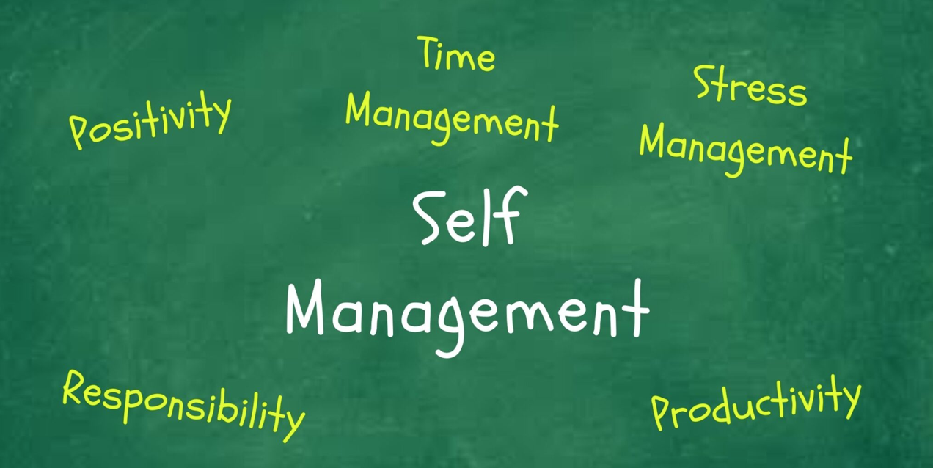
Self-Management
Self-management refers to the ability to manage your emotions, particularly in stressful situations, and maintain a positive outlook despite setbacks. Leaders who lack self-management tend to react and have a harder time keeping their impulses in check.
A reaction tends to be automatic. The more in tune you are with your emotional intelligence, however, the easier you can make the transition from reaction to response. It's important to remember to pause, breathe, collect yourself, and do whatever it takes to manage your emotions—whether that means taking a walk or calling a friend—so that you can more appropriately and intentionally respond to stress and adversity. (Landry, 2019, para. 4).

Slide 10

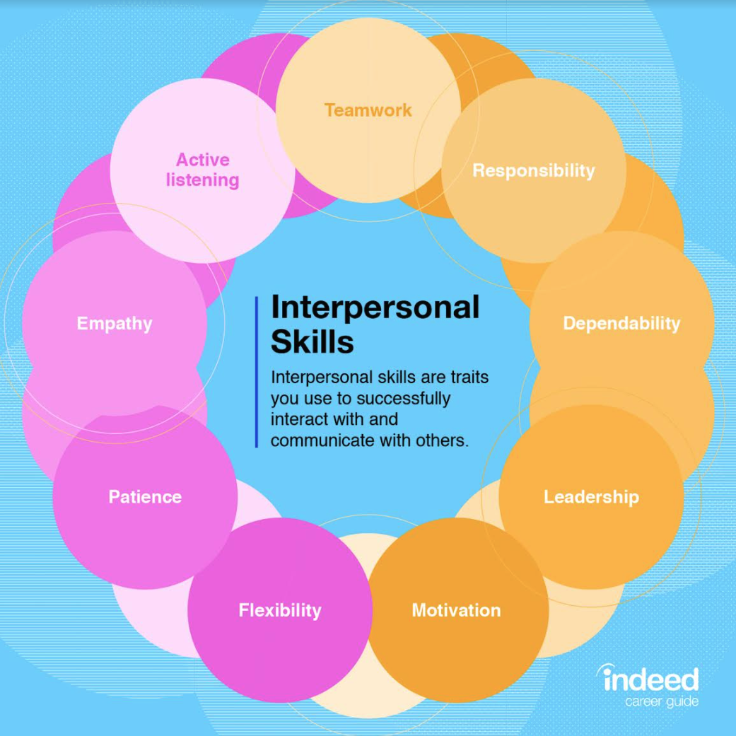
Social Skills
Being able to interact well with others is another important aspect of emotional intelligence. Having strong social skills allows people to build meaningful relationships with other people and develop a stronger understanding of themselves and others.

Slide 11
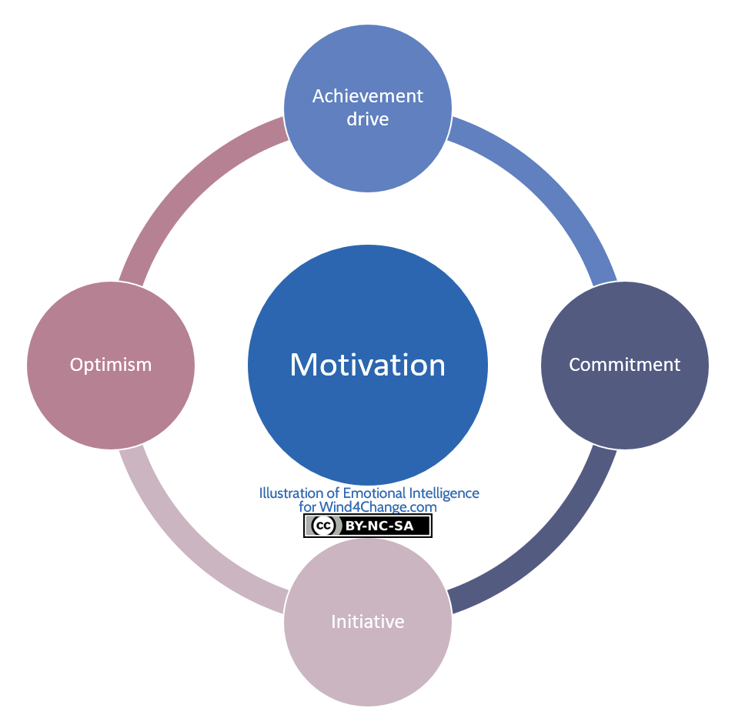
Motivation
Daniel Goleman (1998) identified four elements that make up motivation: our personal drive to improve and achieve, commitment to our goals, initiative, or readiness to act on opportunities, as well as optimism, and resilience. (Oracle, 2021, para. 3).

Slide 12

Empathy
Empathy is, at its simplest, awareness of the feelings and emotions of other people. It is a key element of Emotional Intelligence, the link between self and others, because it is how we as individuals understand what others are experiencing as if we were feeling it ourselves.
Empathy goes far beyond sympathy, which might be considered ‘feeling for’ someone. Empathy, instead, is ‘feeling with’ that person, through the use of imagination. (Skillsyouneed, 2023, para. 1).

Slide 13
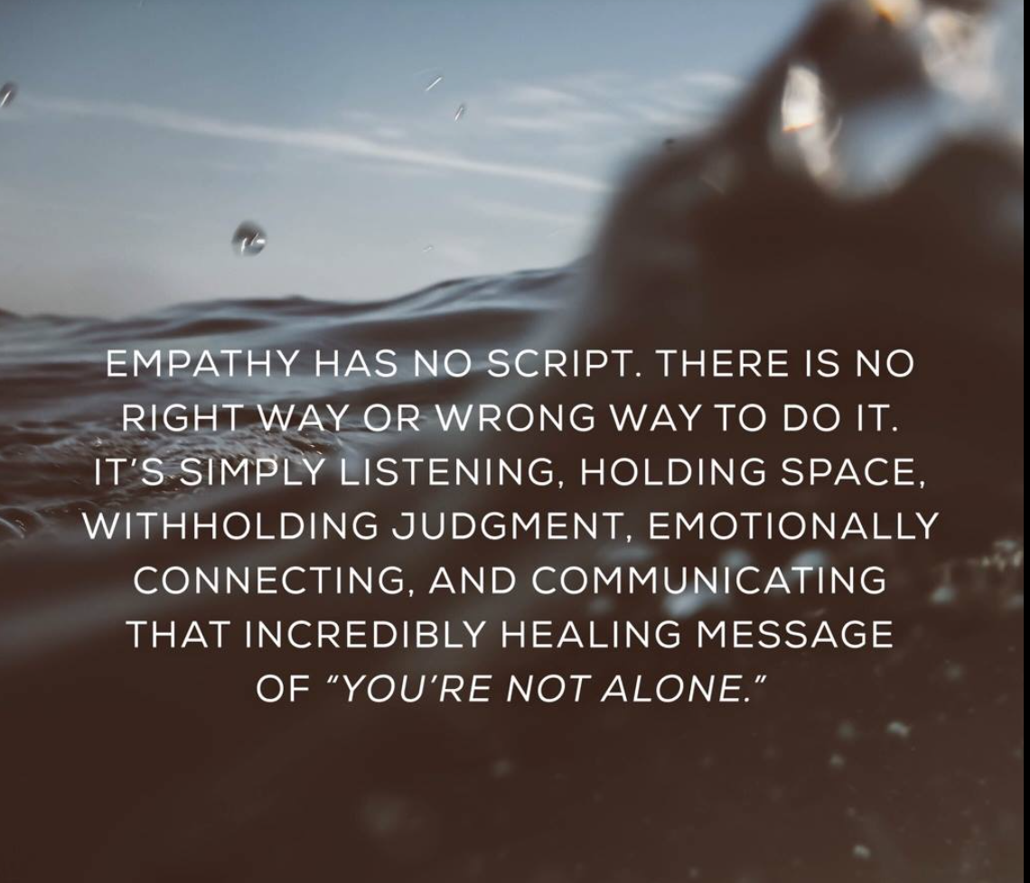
–Dr. Brené Brown

Slide 14


Challenge for Servant Leaders: Relinquishing Control
Many leaders find it difficult to transition from the power and authority that comes with their role in a hierarchical, command-and-control organization. They cannot yet see themselves as servant leaders, or indeed trust their staff enough to devolve responsibility and support them as they grow into their own new roles.
Traditional leaders have nothing to fear and everything to gain from adopting a value-creation, trust-based servant leadership approach. (Whiteside, 2021, para. 3).

Slide 15


Criticism: Servant Leadership
Spears (1995) asserts that servant-leaders are dreamers who need to refine their conceptualizing lens “to address problems that arise from a more global perspective rather than just from within their work environment” (Spears, 1995, p. 6).

Slide 16

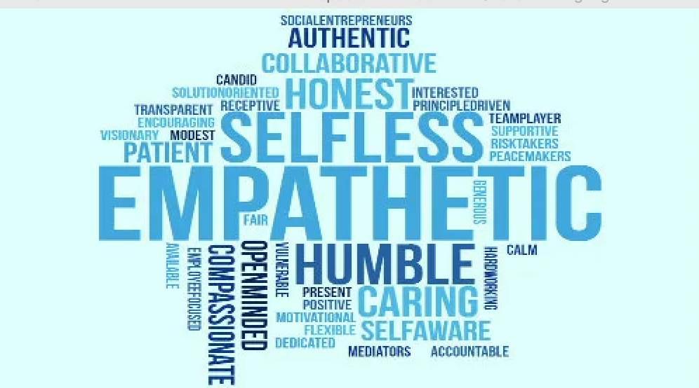
Initiating a Servant Leadership Program
Involves celebrating the positive characteristics while being mindful of the shadow side of Servant Leadership, developing strategic goals for the organization while fostering a compassion-based servant-led culture.

Slide 17
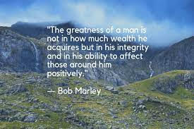

Slide 18
