Slide 1
Servant Leader Behaviors Study: Straight Talk From University Leaders
Karol A.D. Johansen

Slide 2
Part II Examining Servant Leadership Behaviors In Higher Education:
Exploration of a Compassion-based Leadership Model Through The Lens of University Leaders

Slide 3
Advantages and Disadvantages
In terms of the advantages and disadvantages of servant leadership, the leaders shared a number of strengths and perceived lesser strengths of the model.

Slide 4
Advantages | Disadvantages
Allows for maximum growth and development of others Leadership by Example Builds a Positive Work Environment Encourages Others to be leaders Creates a culture of belonging, trust and loyalty | Time intensive Lack of productivity and longer decision-making processes Leader can be perceived as weak Trying to Please Everyone Sometimes does not Fit with Traditional HR rules and Regulations Particularly with Progressive Discipline Issues

Slide 5
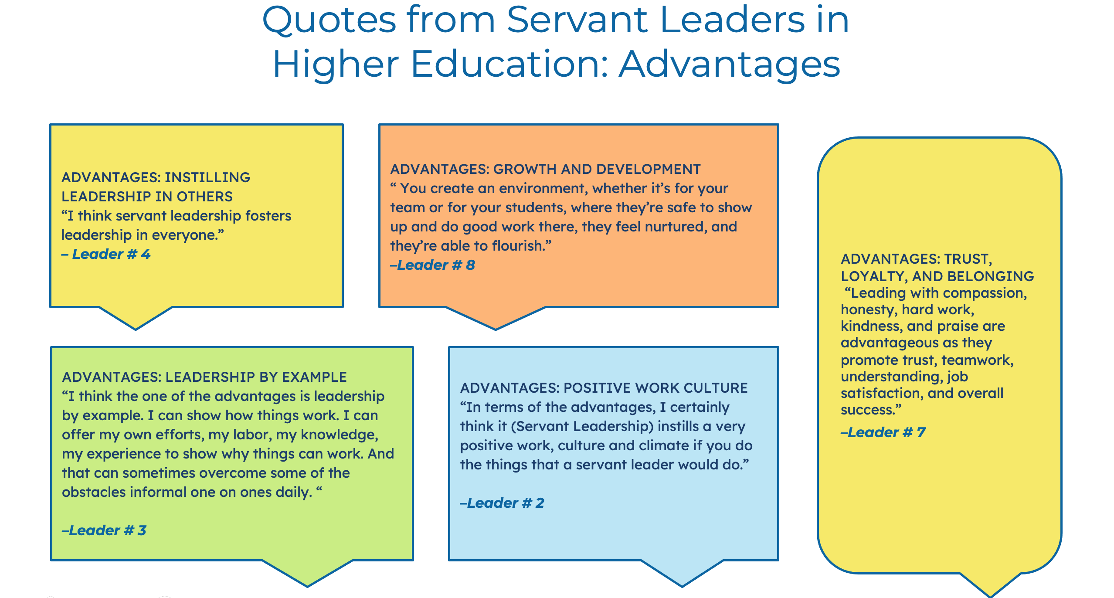

Slide 6
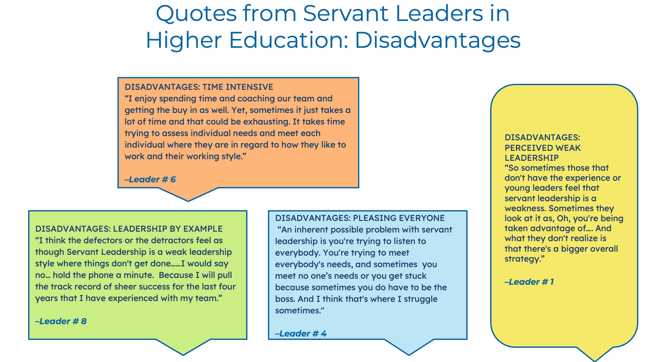

Slide 7
Interview I: Question 3 Asks Leaders:
As a university leader, of the seven behaviors inherent in servant leadership (conceptualizing, emotional healing, putting followers first, helping followers grow and succeed, behaving ethically, empowering, and creating value for the community) (Northouse, 2016) which do you find to be the top three for leaders in higher education and what is your rationale?

Slide 8
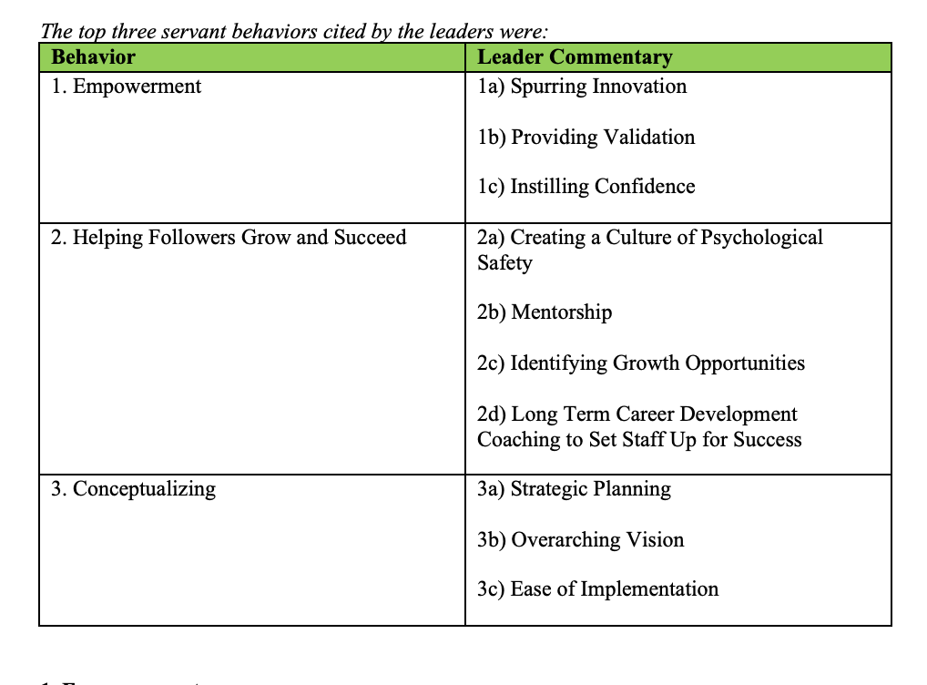

Slide 9

1. Empowerment
According to Northhouse (2016) “empowerment is the process of enabling individuals to take control for themselves of the factors surrounding their circumstances” (p. 702). Servant leadership puts team members first, empowering them to become the best they can be. (Northouse, 2016).
Of the ten leaders interviewed, empowerment was one of the top three behaviors and, in terms of the leaders, each had their own interpretation of the meaning behind empowering others.

Slide 10
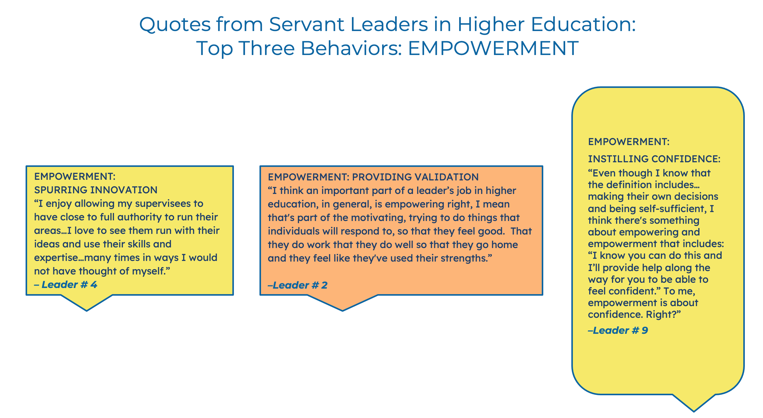

Slide 11
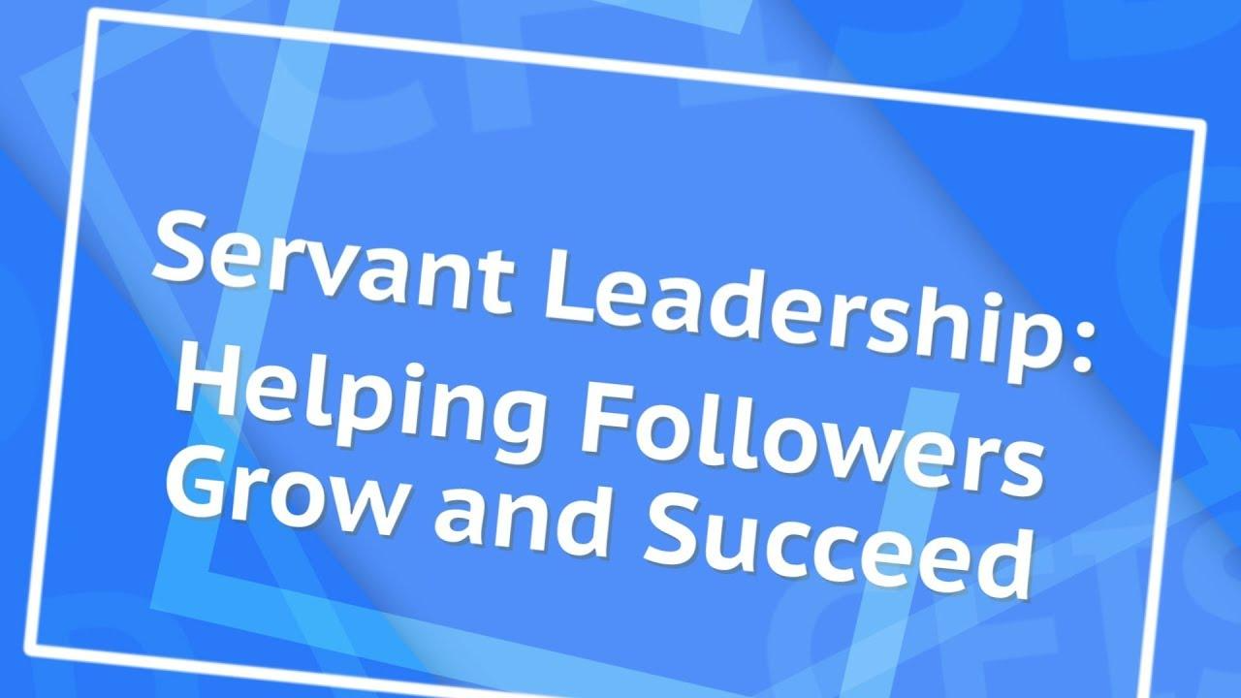
2. Helping Followers Grow and Succeed
Helping followers grow and succeed calls upon a servant leader to support the professional and personal goals of those they lead (Northouse 2021).
Northouse (2021) clarifies that “helping followers grow and succeed is about aiding these individuals to become self-actualized, reaching their fullest human potential” (p. 262).

Slide 12
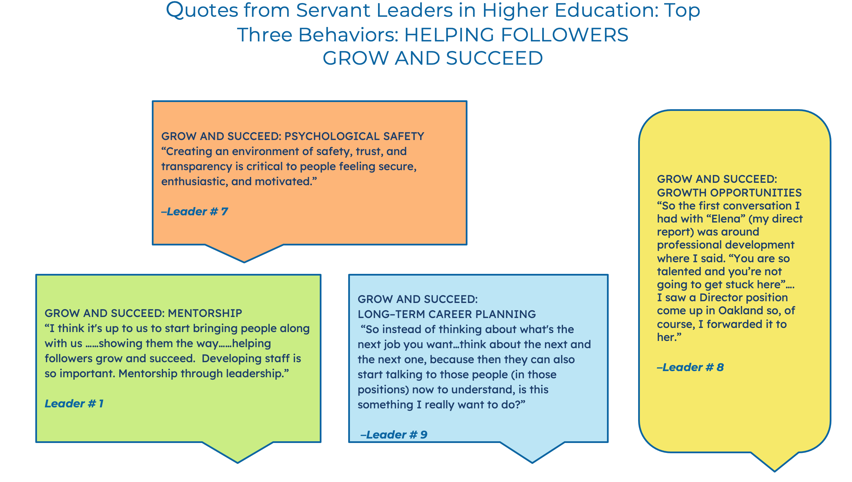

Slide 13

3. Conceptualizing
The traditional leader is driven to accomplish short-term and immediate operational goals.
The leader who subscribes to the servant leader philosophy must expand their leadership orientation to include “broader-based conceptual thinking.” (Ross, 2006).

Slide 14
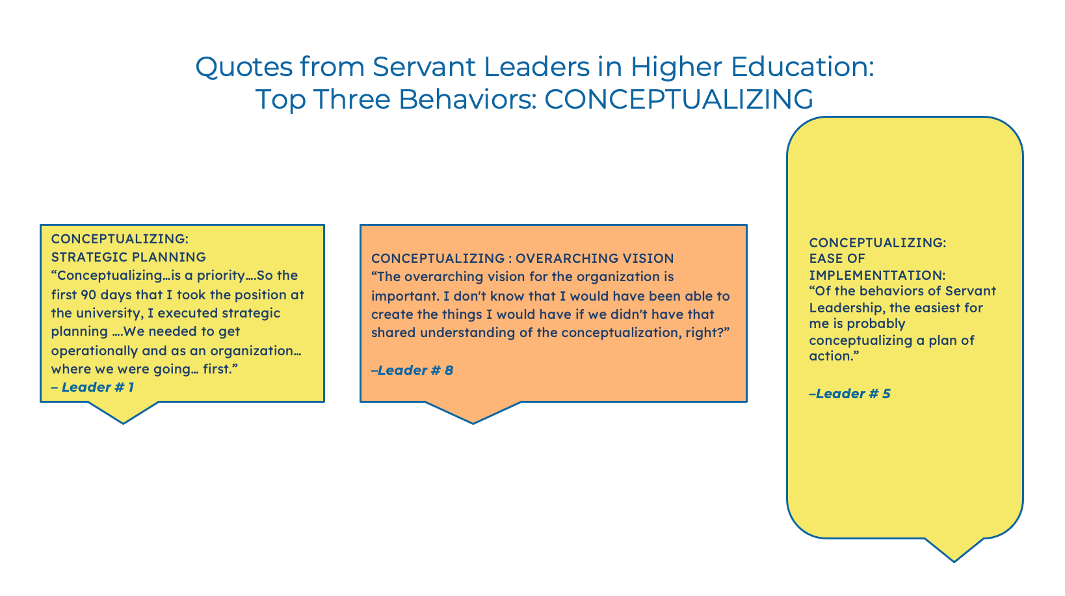

Slide 15
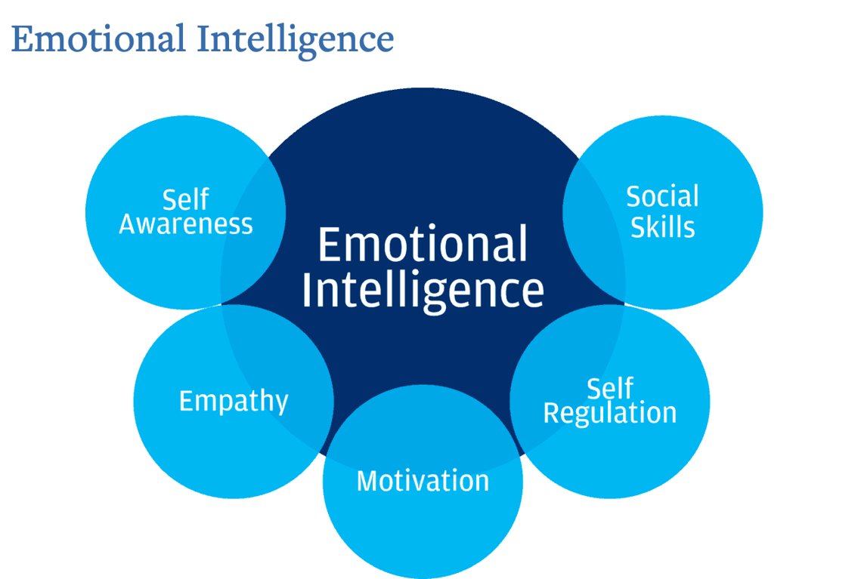
Interview I: Question 4 Asks Leaders: Goleman (2006) contends there are five components of emotional intelligence. Can you offer an example of how you have demonstrated each in a leadership capacity? 1) Self-awareness. 2) Self-Regulation 3) Motivation 4) Empathy 5) Social Skills.
Inspiring and effective leaders must not only be concerned with their technical and operational competencies but also the emotional component of the role. As Landry (2019) explains about the mechanics of emotional intelligence, “It’s what helps you successfully coach teams, manage stress, deliver feedback, and collaborate with others” (para 1).
Emotional Intelligence
Emotional intelligence is defined as having the aptitude to comprehend and be in charge of your own emotions, as well as understand and have an impact on the emotions of those who are in your circle of influence (Landry, 2019). Psychologist Daniel Goleman popularized the concept and emphasized how critical it is to leadership. “The most effective leaders are all alike in one crucial way: They all have a high degree of what has come to be known as emotional intelligence” (Landry, 2019, para 4).

Slide 16
Emotional Intelligence Domains and Leader Commentary Themes
1. Self-Awareness | 2. Self-Regulation | 3. Motivation | 4. Social Skills
Spending time in self-reflection Engaging the whole person approach Avoiding overstaying in a leadership role Soliciting feedback for growth | Using one’s voice strategically Thoughtful and discerning Communication Being cognizant of workplace triggers | Mission and purpose as a driving force Focus on manageable parts Democratizing access to opportunities | Creating relationships Facilitating change Modeling the way to react

Slide 17
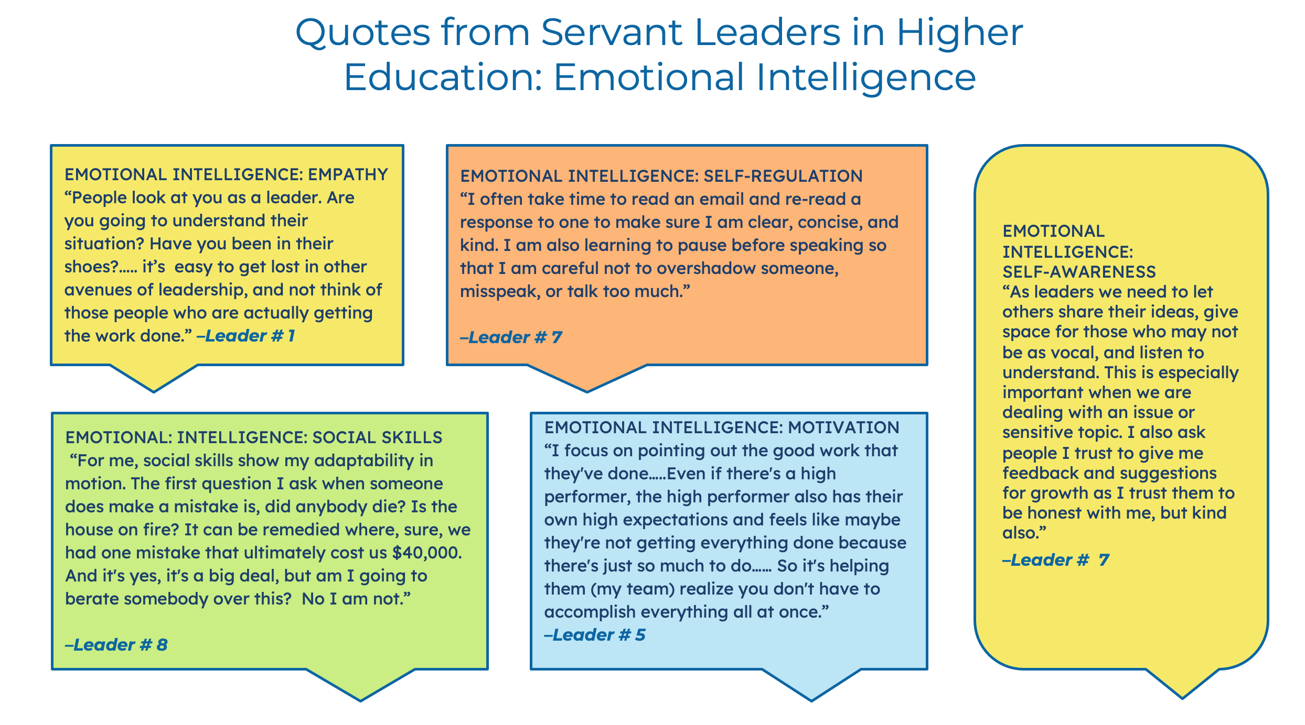

Slide 18
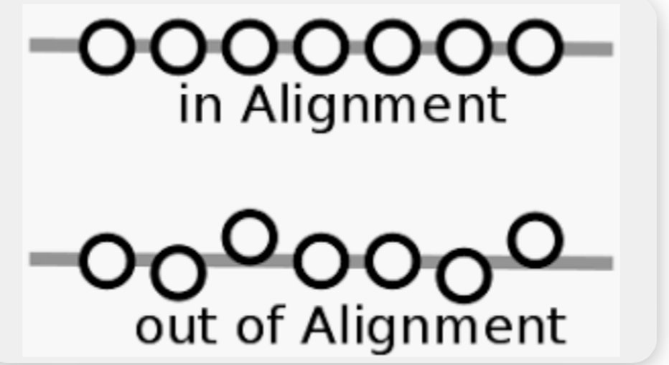
Interview II: Question 5 Asks Leaders: To what extent is servant leadership a model that would be positively aligned with the goals, mission, values, and work culture inherent in your work setting.
The leaders responded to this question covering the following areas:
Overall Alignment with Higher Education
Alignment with Compliance Based Units on Campus
A View through the lens of the University’s Strategic Plan
Implementation with External Groups
Servant Leadership: Overall Alignment with Higher Education.
The majority of the leaders contend that servant leadership is a strong fit for a university setting. However, the responses to this question are quite layered and nuanced. This question is rooted in complexity as well as subjectivity in terms of the lens of the leaders and depending on the mission as well as the purpose of the leader’s immediate work group and overall unit.

Slide 19
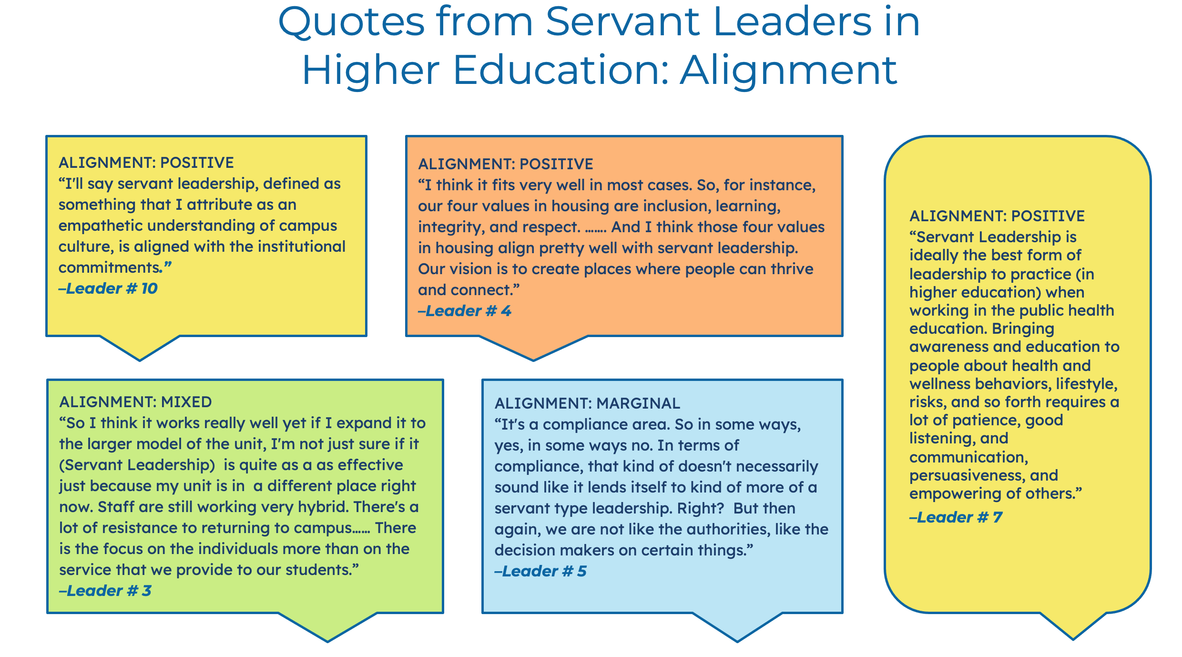

Slide 20
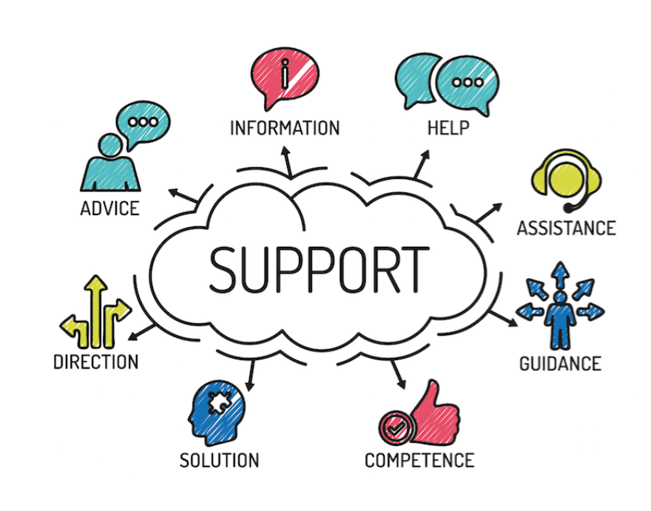
Interview II: Question 6 Asks Leaders: Tell me about a specific time when you provided support to a direct report.
The literature and empirical studies show that servant leadership nurtures the emotional well-being of employees due to the creation of a positive and psychologically safe work environment created (Jit et al., 2017; Black, 2010; Jaramillo et al., 2009; Nuebert et al., 2008).
Each leader in this study was able to recall a specific instance where they provided emotional support to direct reports. The answers ranged from stepping in to provide day-to-day support to intervening in sensitive situations to mitigating emergencies to advocating for training and resources for staff.

Slide 21
Interview II: Question 6 Asks Leaders: Tell me about a specific time when you provided support to a direct report.
Leaders Provide Support to Direct Reports in a Multitude of Ways
Providing Daily Support and Emergency Interventions | Troubleshooting, Preventing Burnout and Advocating for Staff Resources | Training and Development of Staff
Day to Day Support Emergency Interventions Support During Employee Health Crises | Promoting Work Life Balance Preventing Burn Out Advocating for Improved Resources | New Employee Onboarding Support Identifying and Encouraging (DEIB) Professional Development Opportunities

Slide 22
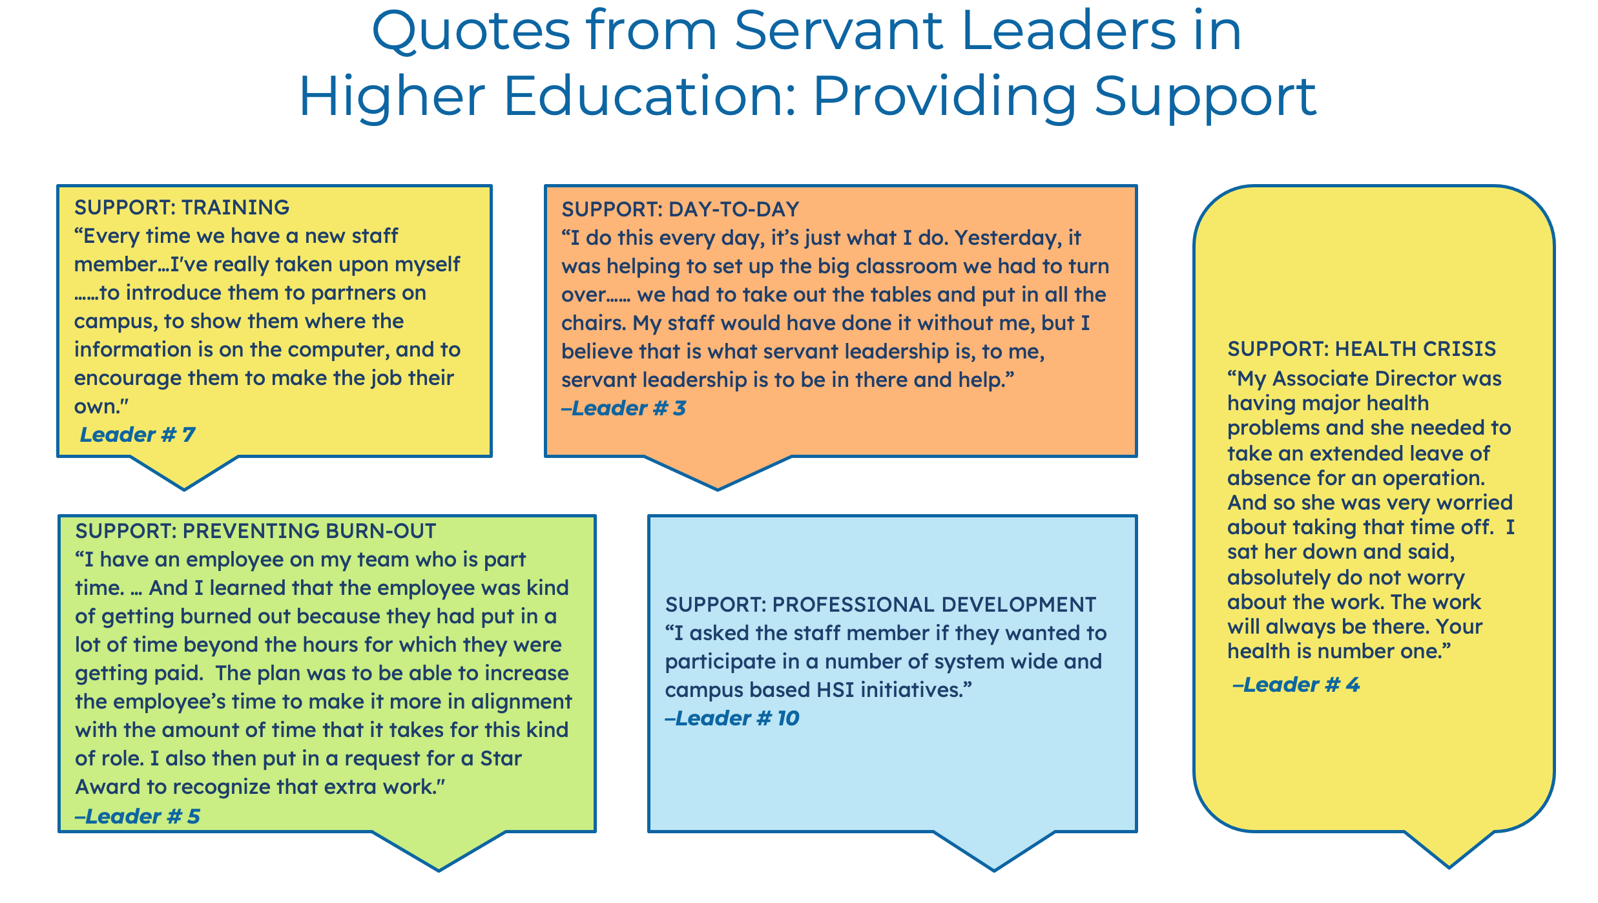

Slide 23
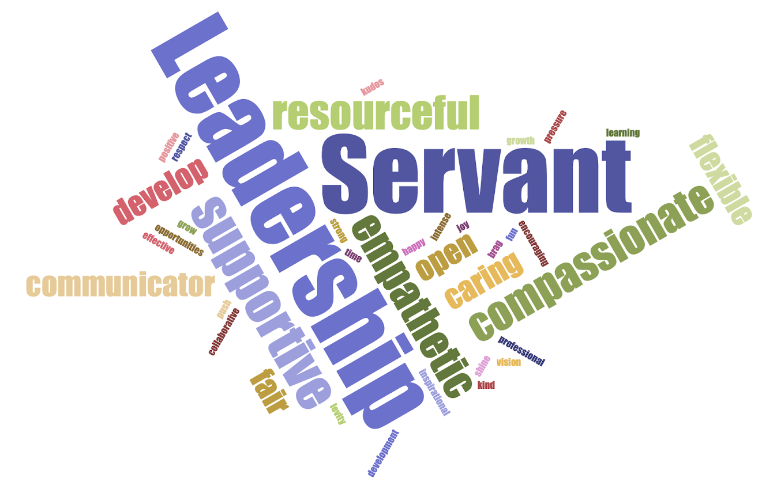
Interview II: Question 7 Asks Leaders: If I spoke with past and current direct reports, how would they describe your leadership style?
With its people centered focus, servant leadership fosters an ethical workplace and a culture of trust (Burton et al., 2017). Each of the leaders were asked how they felt their team would describe their leadership style. The following word cloud was created with the words supplied by the leaders.
The leaders shared insights regarding how they feel their staff would describe how they actually lead their respective teams, covering the following categories of leadership:
Approachability
Providing Support
Producing Results
Taking In Too Much
Not Matching the Stereotype of a Leader
Follow Through
Communication
Building Positive Relationships
Letting Staff Shine

Slide 24

Interview II: Question 8 Asks Leaders: Do you think the global pandemic has impacted your ability to practice servant leadership? If it has, please provide specific examples.
Higher education will never be the same after the global pandemic. During this period of post-Covid reflection and recovery, university leaders are facing many layers of ambiguity and scores of questions from university staff, many without concrete answers. They are grappling with how to pivot, adjust, and move forward, maintaining necessary institutional operations, while inspiring a movement towards future resilience (Thompson et al., 2023).
For the leaders that participated in this study, navigating this post-lockdown world means facing many challenges and unprecedented areas of uncertainty along with opportunities for reimagining the
Wrestling with Remote versus In-person and/or Hybrid Work Models.
Pandemic-Inspired Leadership Growth and Development.
Assessing One’s Own Leadership Style and Consider Ways to Improve.
Pandemic and Hybrid Work-Induced Isolation.
Forced Adaptability to Retain Staff.

Slide 25

Examining Servant Leader Behaviors identifies specific servant leader behaviors practiced in a university setting. The study identified behaviors implemented with ease as well as those which pose a challenge.
This study fills a gap in servant leadership scholarly literature as most studies focus on faculty as opposed to university leaders of staff.
There is no better time to examine compassion-based leadership models in university settings given the cataclysmic events of a Triple Pandemic (Covid 19, systemic racism, and economic distress) compounded by the Great Resignation in Higher Education.
While not a perfect fit, based on the interviews of the ten servant leaders in this study, this model of compassion based leadership is complementary with the mission, vision and practices inherent in higher education.
The information gathered in this study was used to create the Servant Leader Training Guide, a Toolkit to support in the training and development of future leaders.

Slide 26
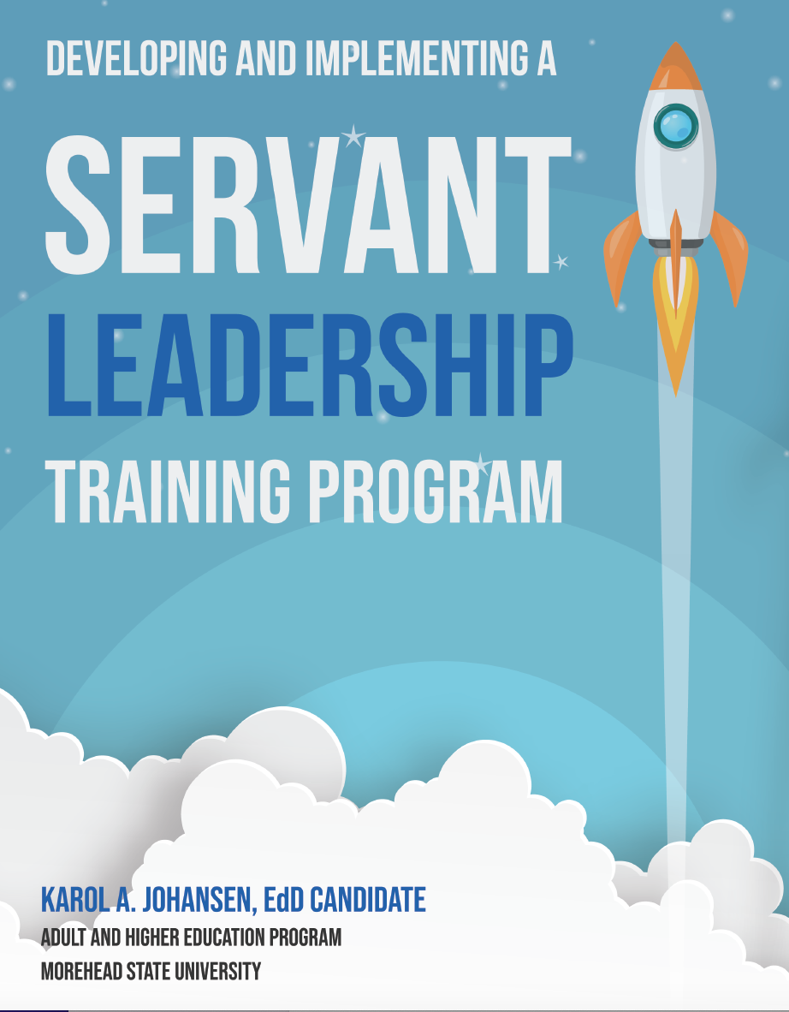

Slide 27
The testimony of “lived leadership experiences” from the ten leaders in this study has been interwoven and the following components of the servant leadership model are explored in the guide:
1) Understanding Servant Leadership
2) How to Practice Servant Leadership
3) The Actual Practice of Servant Leadership
4) Servant Leader Behaviors: Highlights from Interviews with Servant Leaders
The guide will serve as a toolkit for higher education leaders to create healthy, positive, and productive work cultures where university staff members can grow, develop, and ultimately thrive.

Slide 28

CONTRIBUTIONS TO THE LITERATURE
While there is a robust amount of academic research on servant leadership in general, and the benefits of this model, there is an absence of qualitative research on leader behaviors (of staff) that contribute to servant leadership in higher education settings.

Slide 29

Potential for Future Research
While this focuses on university servant leaders, it would be insightful to conduct a study on the direct reports of university servant leaders.
How are direct reports impacted by servant leadership?
Do they feel that servant leadership has contributed to a healthier work culture?
What are the benefits and downside of being led by a servant leader?
What are the key servant leader behaviors they have observed in their leaders?
Do they feel servant leadership is conducive to the mission, values, and practices inherent in higher education?

Slide 30
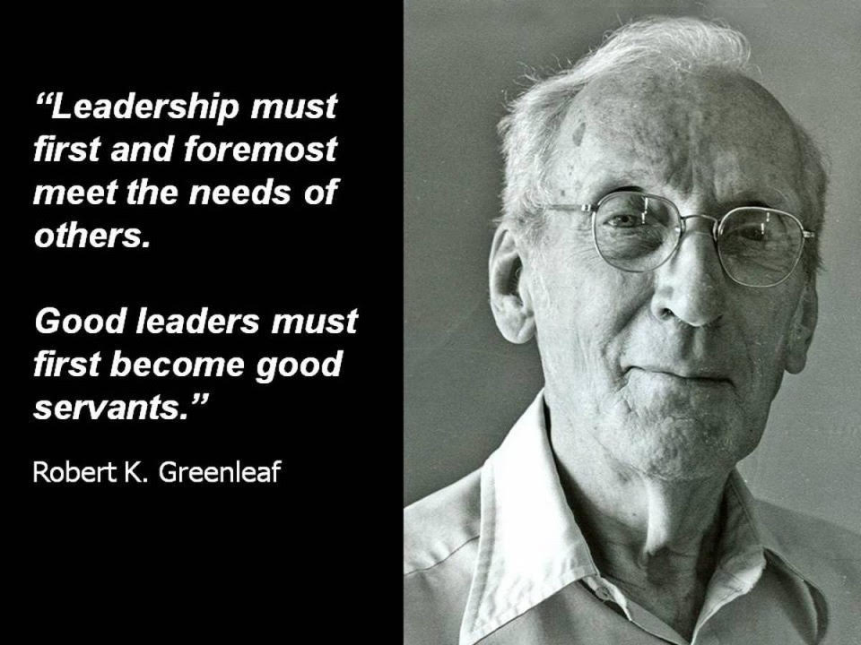

Slide 31
References
Black G. L. (2010). Correlational analysis of servant leadership and school climate. Catholic education: A Journal of Enquiry and Practice, 13(4), 437–466.
Burton, L. J., Peachey, J. W., & Wells, J. E. (2017). The role of servant leadership in developing an ethical climate in sport organizations. Journal of Sport Management, 31(3), 229-240.
Goleman, D. (1998, March). The emotionally competent leader. In The Healthcare Forum Journal (Vol. 41, No. 2, pp. 36-38).
Goleman, D., Boyatzis, R., & McKee, A. (2002). The emotional reality of teams. Journal of Organizational Excellence, 21(2), 55-65.
Greenleaf, R. K. (1970). The servant as leader. Indianapolis, IN: The Robert K. Greenleaf Center.
Harper-Anderson, E. L., Albanese, J. S., & Gooden, S. T. (Eds.). (2023). Racial Equity, COVID-19,
Hendry, P., Quinn, M., Mitchell, R., & Bach, J. (Eds.). (2023). Curriculum Histories in Place, in Person, in Practice: The Louisiana State University Curriculum Theory Project. Taylor & Francis
Jaramillo, F., Grisaffe, D. B., Chonko, L. B., & Roberts, J. A. (2009). Examining the impact of servant leadership on salesperson’s turnover intention. Journal of Personal Selling & Sales Management, 29(4), 351-365.
Jit, R., Sharma, C. S., & Kawatra, M. (2017). Healing a broken spirit: Role of servant leadership. Vikalpa, 42(2), 80-94. Chicago.
Landry, L. (2019). Why Emotional Intelligence is Important in Leadership. Retrieved from: https://online.hbs.edu/blog/post/emotional-intelligence-in-leadership
Neubert M. J., Kacmar K. M., Carlson D. S., Chonko L. B., Roberts J. A. (2008). Regulatory focus as a mediator of the influence of initiating structure and servant leadership on employee behavior. Journal of Applied Psychology, 93(6), 1220–1233.

Slide 32
References
Northouse. P. (2016). Leadership: Theory and Practice. 7th edition. Thousand Oaks, CA: SAGE publications.
Northouse, P. G. (2021). Leadership: Theory and practice. Sage publications.
Rasool SF, Maqbool R, Samma M, Zhao Y, Anjum A. (2019). Positioning Depression as a Critical Factor in Creating a Toxic Workplace Environment for Diminishing Worker Productivity. Sustainability.; 11(9):2589. https://doi.org/10.3390/su11092589
Roark, C. S., & Beuthin, T. M. (2014). A MIXED-METHODS STUDY EXPLORING THE RELATIONSHIP BETWEEN SERVANT-LEADERSHIP AND EMOTIONAL INTELLIGENCE. The International Journal of Servant-Leadership, 10(1), 249-277.
Saeed, A. A. R., Tatlah, I. A., & Yousaf, A. (2022). PERCEPTIONS OF FACULTY MEMBERS’ REGARDING SERVANT LEADERSHIP PRACTICES OF THE DEPARTMENT HEADS. Jahan-e-Tahqeeq, 5(1), 108-118
Thompson, S., & Hoy, X. (2023). Navigating the crucible of crisis: effective leadership strategies for higher education COVID-19 recovery. In Innovation, Leadership and Governance in Higher Education: Perspectives on the Covid-19 Recovery Strategies (pp. 257-275). Singapore: Springer Nature Singapore.
Troyani, L. (2022). The Great Resignation Research Report: What’s Really Driving American Employees To Give Their Two Weeks’ Notice. Plan Beyond.
Wong, P. T., & Page, D. (2003, October). Servant leadership: An opponent-process model and the revised servant leadership profile. In Proceedings of the Servant Leadership Research Roundtable (Vol. 1, No. 11).

