Slide 1
The Actual Practice of Servant Leadership
Karol A.D. Johansen, EdD
Notes:
I changed the first slide to add “proposal”

Slide 2
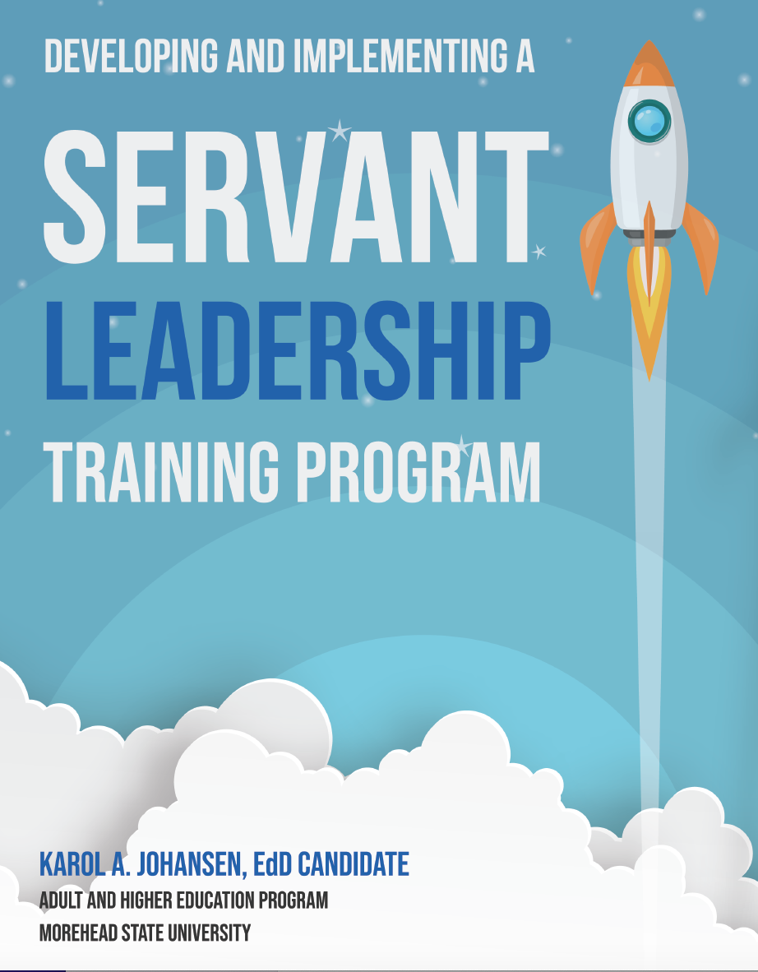

Slide 3
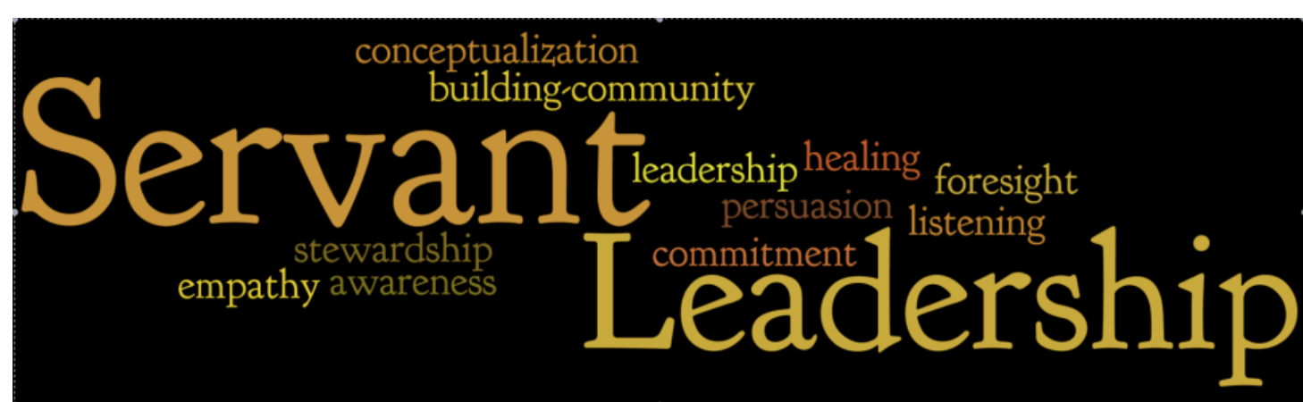

Slide 4
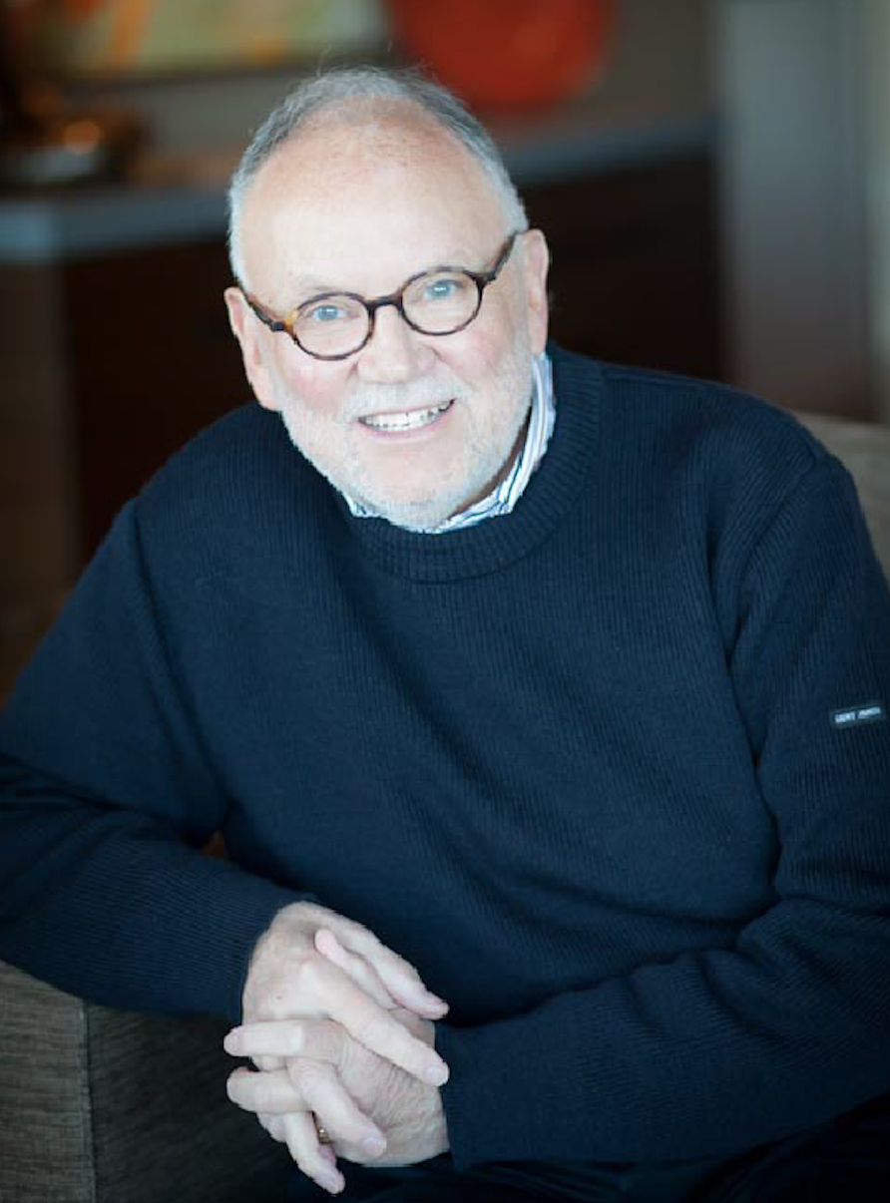
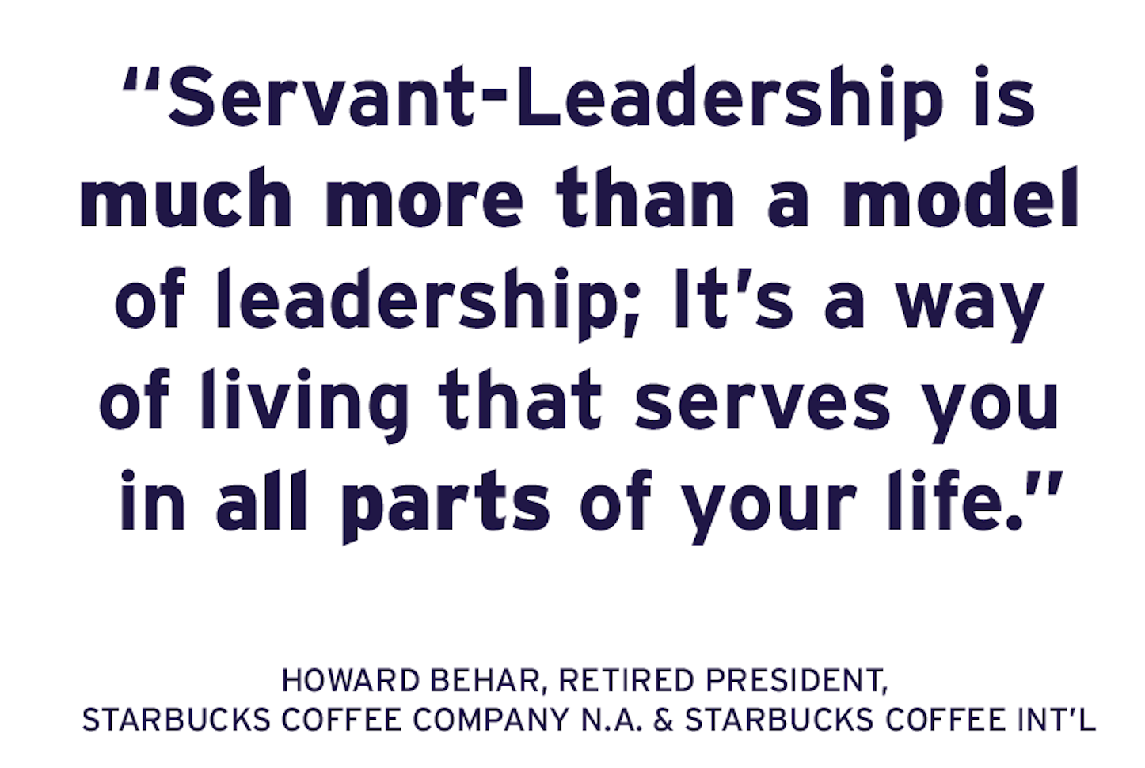
Principles of Servant Leadership at Starbucks
Servant leadership is a powerful approach that supports Starbucks’ business model is aligned with servant leadership and the existing organizational culture. As a value-added component to corporate culture, Starbuck's leadership focuses on guiding and mentoring employees. (Studycorgi, 2021).

Slide 5
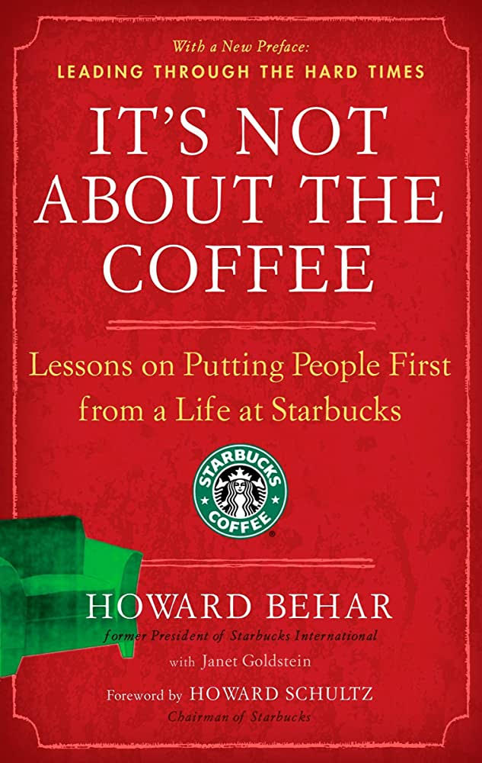
Howard Schultz’s leadership style at Starbucks is admired and analyzed by many scholars. As the corporation’s chief executive officer (CEO), he applied servant leadership efficiently in order to empower his followers. This practice resulted in a positive culture that continues to drive the company’s performance. (Studycorgi, 2021, para. 1).

Slide 6
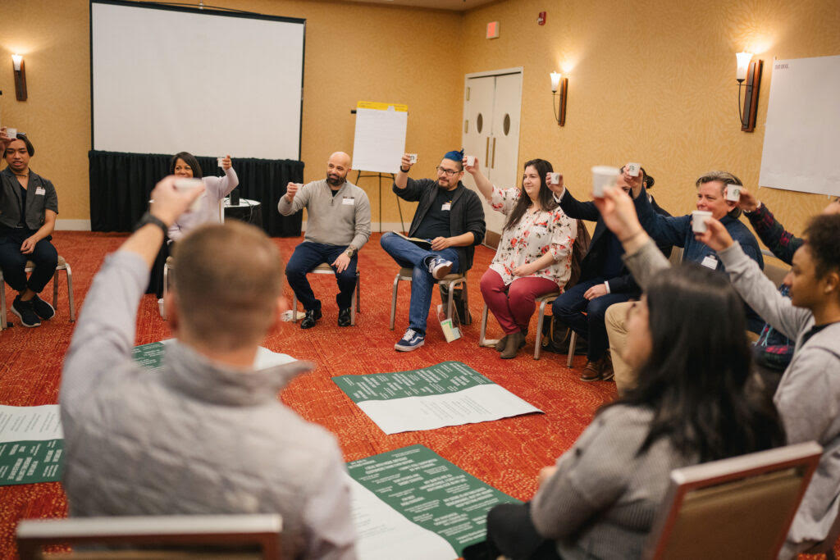
Servant Leadership Forums: Improved Communication
The concept of openness has made it easier for Starbucks to achieve its goals. The organization introduced open forums several years ago to improve the level of communication between employees and managers (StudyCorgi, 2021, para. . This practice fostered a supportive environment to motivate workers and promote creativity (Ng et al., 2016).

Slide 7
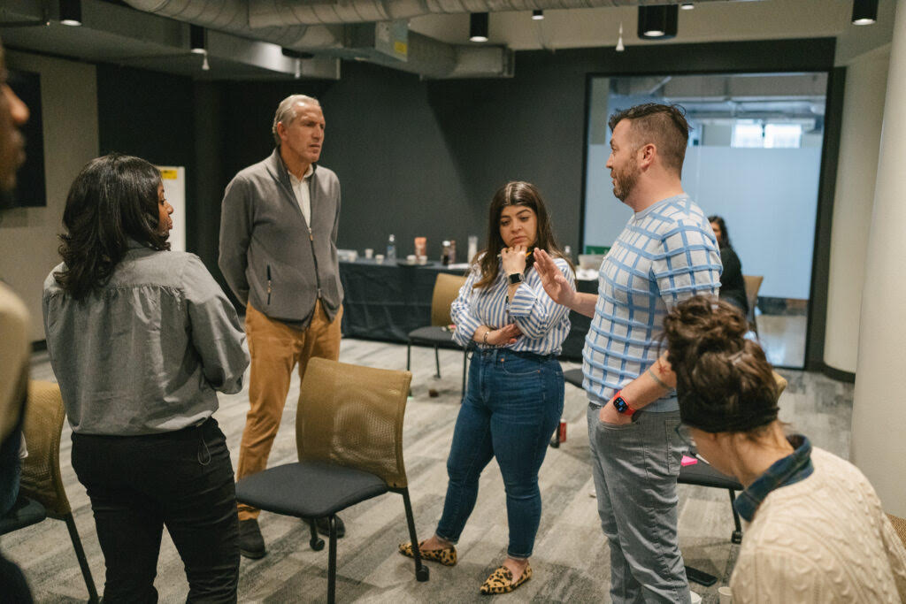
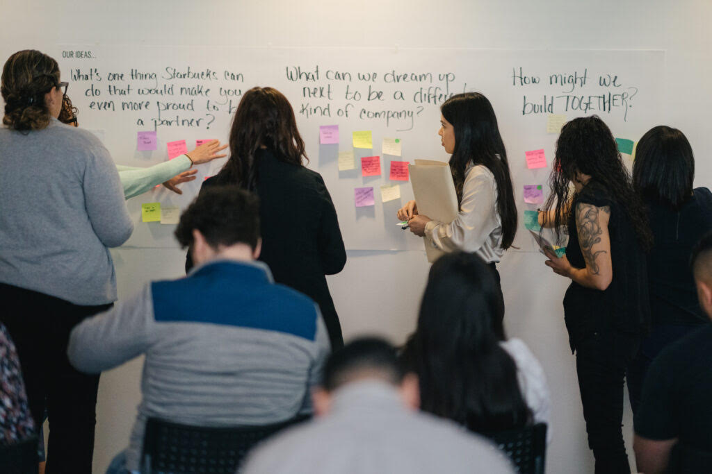
Collaboration at Starbucks
Another principle taken seriously at this company is that of collaboration (Studycorgi, 2021, para. 3).
Employees and managers communicate efficiently, share ideas, and make evidence-based decisions (Ng et al. as cited in Studicorgi, 2021, para. 3). Workers are encouraged to ask questions and identify new resources that can add value to the targeted customers. Consequently, Starbucks continues to achieve most of its business goals. (Studycorgi, 2021, para. 3).

Slide 8
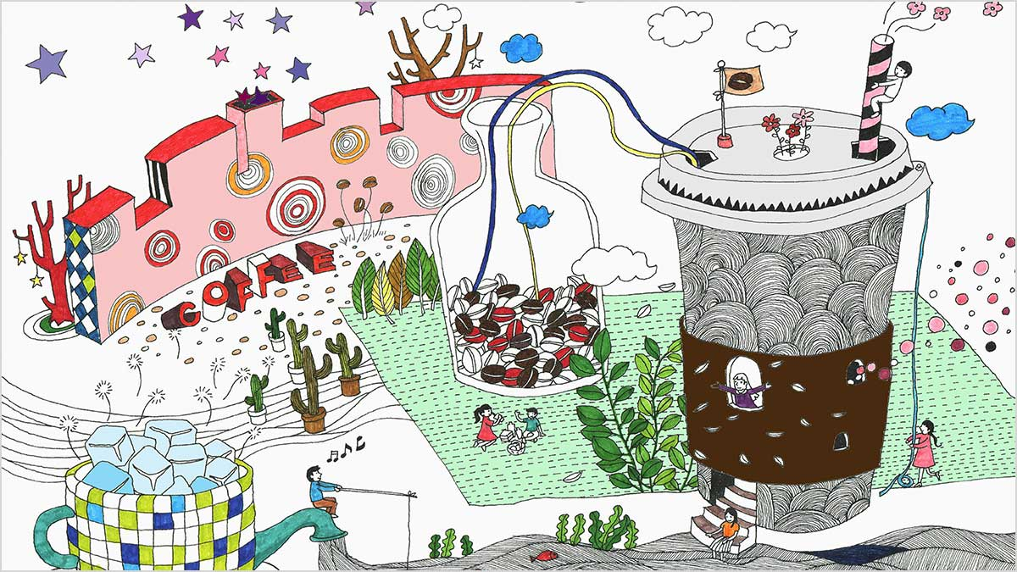
Starbucks embraces a relationship-driven approach to establish a positive connection with members of the community. It also incorporates an anti-discrimination policy to support this practice. (Studycorgi, 2021),
The organizational model creates an embracing culture that promotes diverse ideas. (Coetzer, Bussin, & Geldenhuys, 2017).
The existing culture “supports effective programs and policies that borrow a lot from the concepts of servant leadership.” (Studycorgi, 2021, para. 4). For example, Starbucks’ managers are committed to providing guidance to team members and “emerging issues are addressed within a short time.” (Studycorgi, 2021, para. 4).

Slide 9
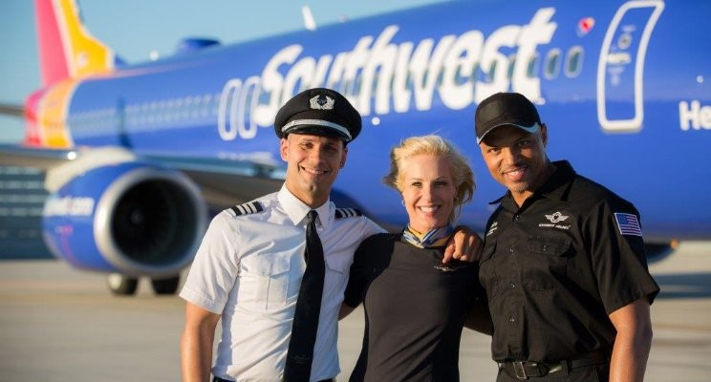
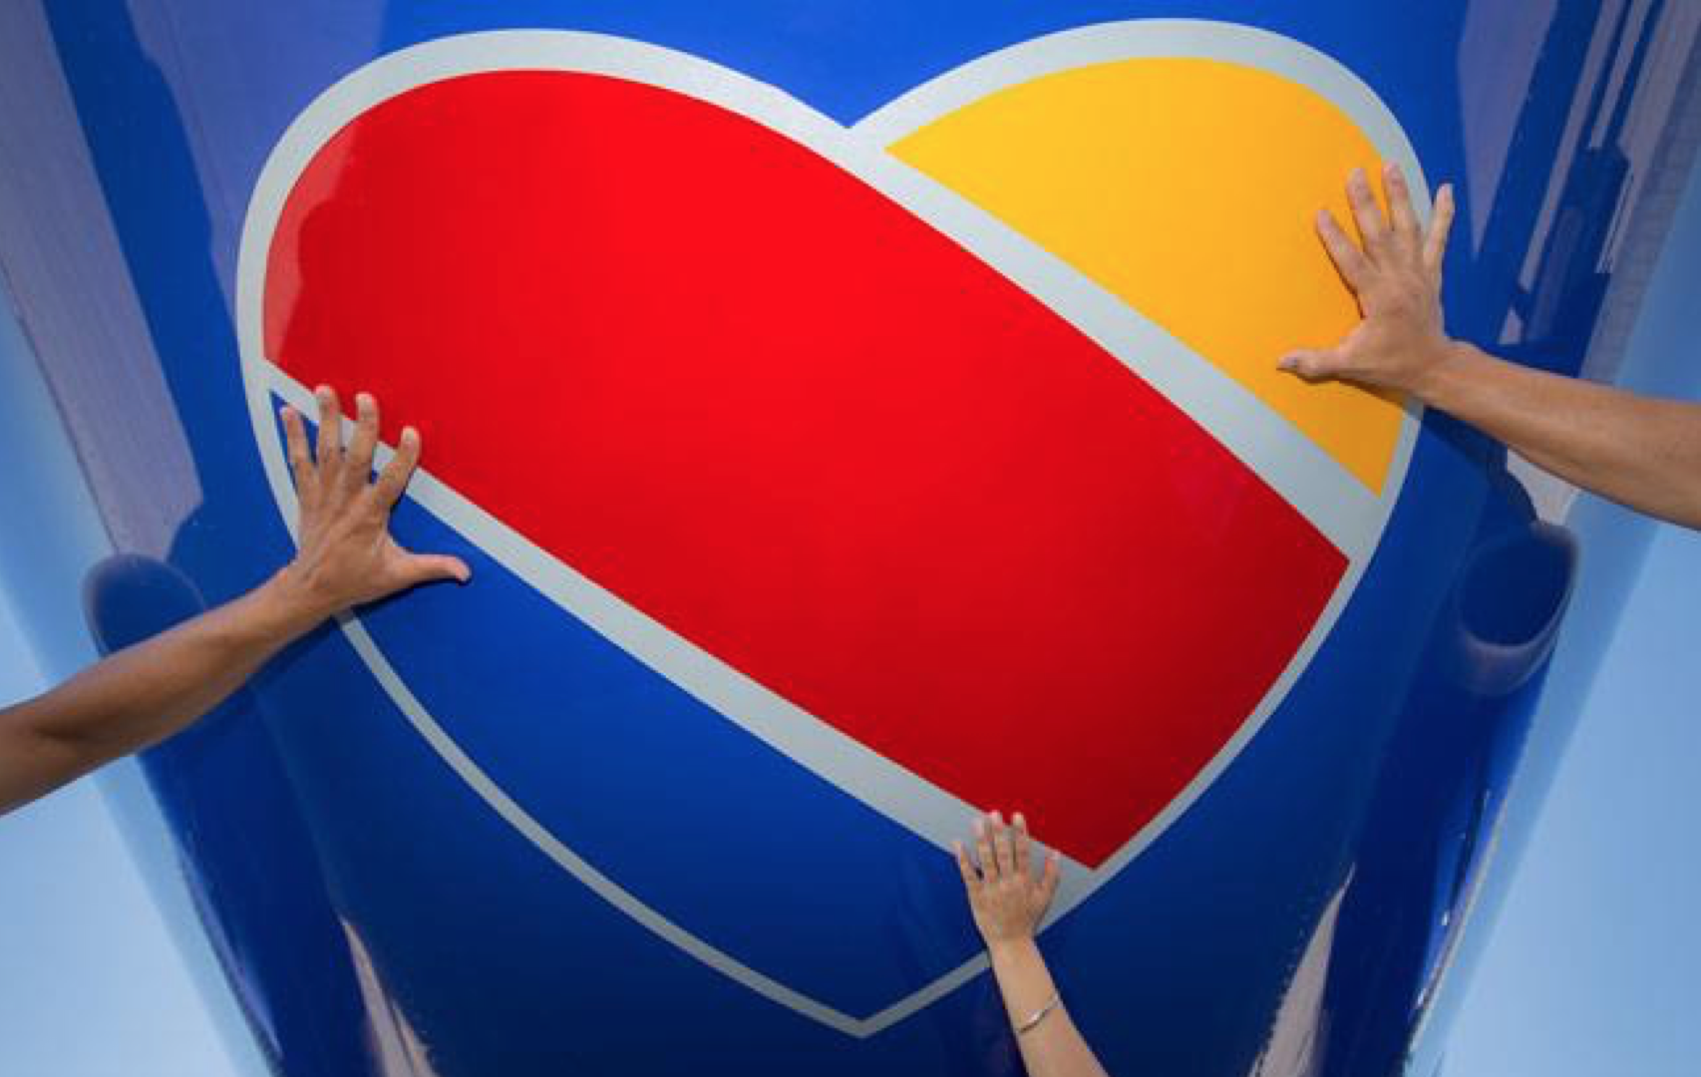
Southwest Airlines’ servant leadership model results have had a positive effect on both customer relations and profitability. (Studycorgi, 2021). The case studies of Southwest Airlines and Starbucks can be used as positive operational examples of the servant leadership model.

Slide 10
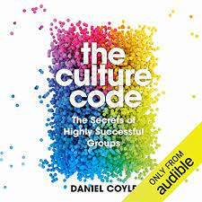

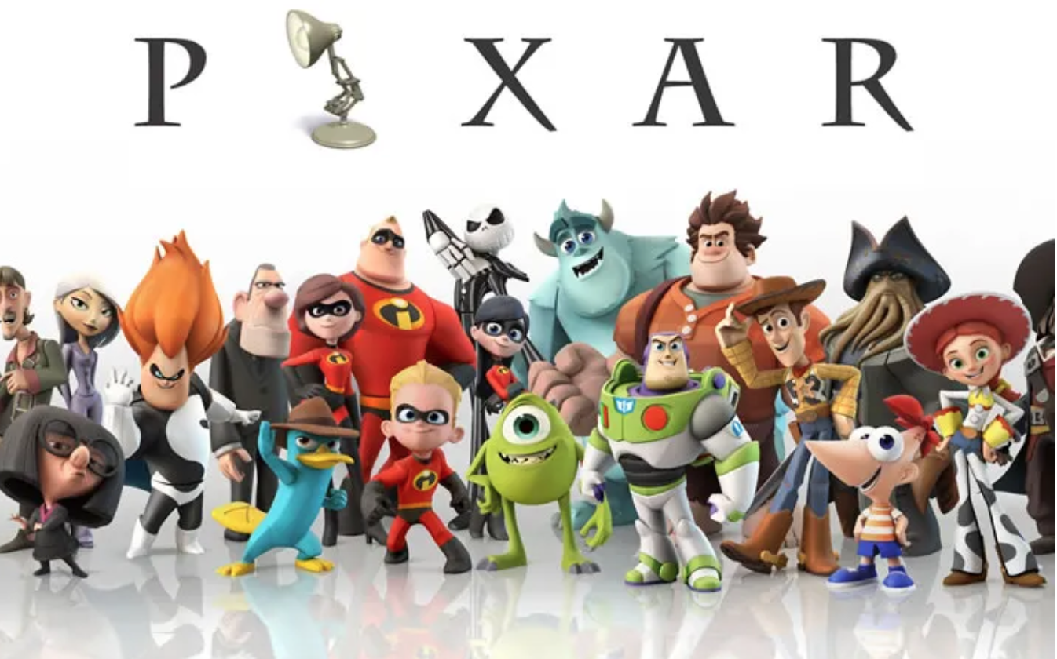

Daniel Coyle a New York Times bestselling author of The Culture Code. Coyle spent the past seven years studying and visiting top-performing group cultures—like Pixar, San Antonio Spurs, IDEO, and military special-operations units—and collecting their best culture-building methods. (Coyle, 2022).

Slide 11
Five Tips for Practicing Servant Leadership

Slide 12

1. Amplify your warmth.
Think about the best, most cohesive group you’ve ever been a part of. Maybe it was through sports, with family, or at work.
As a part of that group, you felt that signature sense of energy, selflessness, and possibility; we call this “group chemistry,” because it feels like magic. But it’s not magic—it’s psychological safety, and it happens through behaviors called belonging cues.
A belonging cue is a short, simple, warm behavior that says, “I see you. I care. You have a voice here. We share a future.” Strong cultures send belonging cues like crazy. (Coyle, 2022, para. 3 ).

Slide 13

2. Share your fallibility.
“The four most important words a leader can say are, ‘I screwed that up.’”
As Navy SEALs commander Dave Cooper puts it, the four most important words a leader can say are, “I screwed that up.” These words give everybody permission to be vulnerable, share fallibility, and get better together. (Coyle, 2022, para. 4).

Slide 14
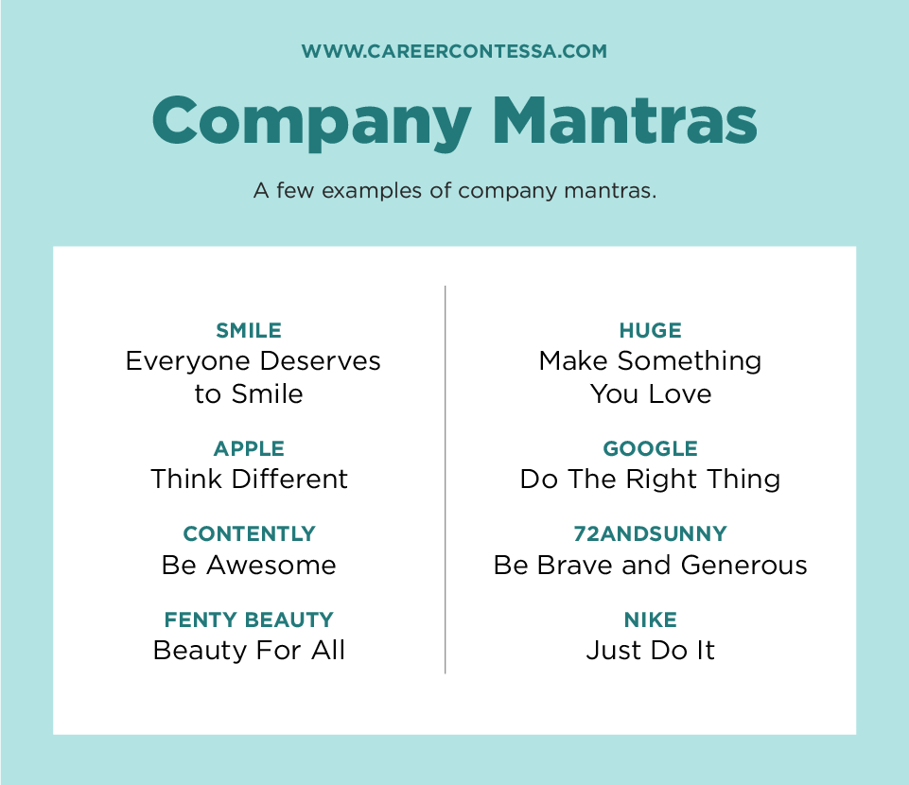
3. Use corny mantras.
“Corny mantras are GPS beacons for the group. They aren’t corny—they’re genius.”
You might think that great cultures would avoid using corny mantras, but you’d be wrong—they all do. It’s not about the mantra, but about how the mantra helps navigate toward true north. (Coyle, 2022, para. 8-10).

Slide 15
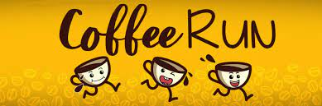

4. Embrace deep fun, instead of shallow fun.
Shallow fun happens during activities where fun is the goal, like ping-pong, foosball, or happy hours. Shallow fun is great, but it’s a sugar high—it wears off without leading to deeper relationships. Deep fun, on the other hand, happens when groups seek activities that improve group life—that boost some element of the shared experience.
We see a great example of deep fun with a small company in Michigan that decided to track down the best coffee on the planet for their office. They put together a team to find the best bean, best roaster, and best machine, and bring it back for the group to enjoy. (Coyle, 2022, para. 11-12 ).

Slide 16


5. Experiment relentlessly.
Hybrid work, social justice, shifting norms and values around work—they all add up to pose the same question to every group: how do you navigate change? How do you, on the fly, change the way you work?
The answer is to experiment, experiment, and then experiment some more. Building culture is not like putting together Legos; you don’t just complete a set of steps and expect results. You have to play and probe, amplify small wins, and see what works in your context. (Coyle, 2022, para. 11-13).

