Slide 1
Understanding Servant Leadership
Karol A.D. Johansen, EdD
Notes:
I changed the first slide to add “proposal”

Slide 2
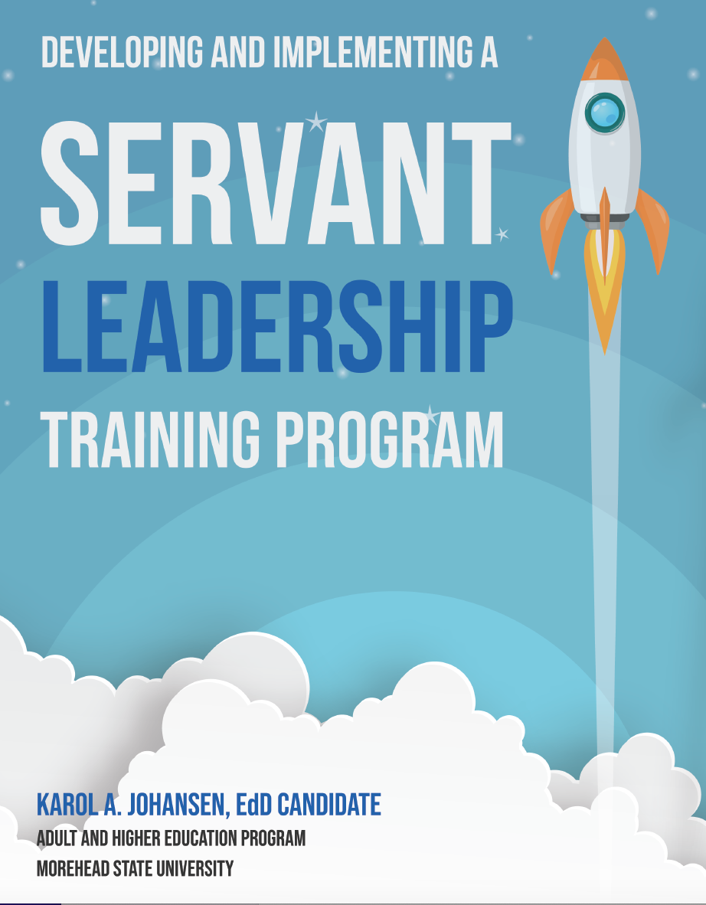

Slide 3
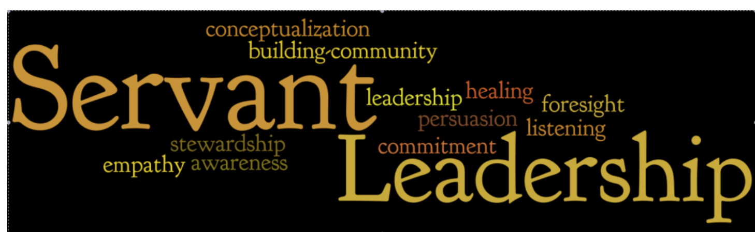

Slide 4
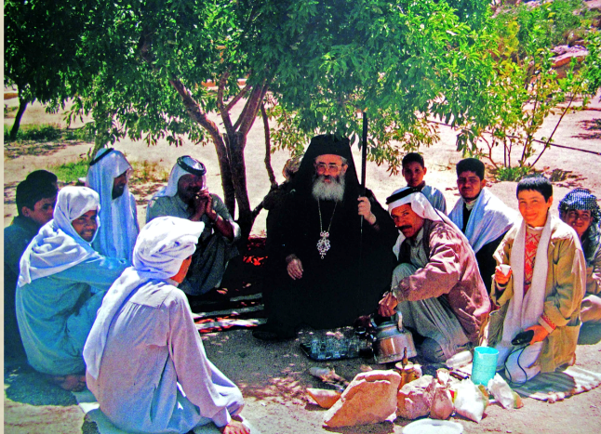
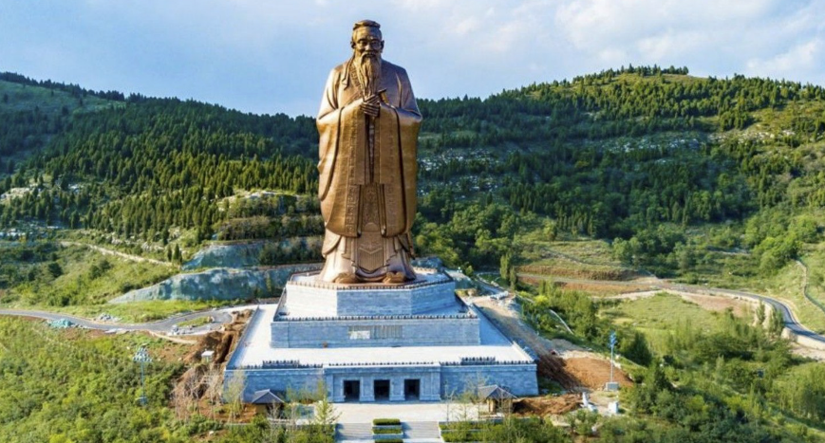
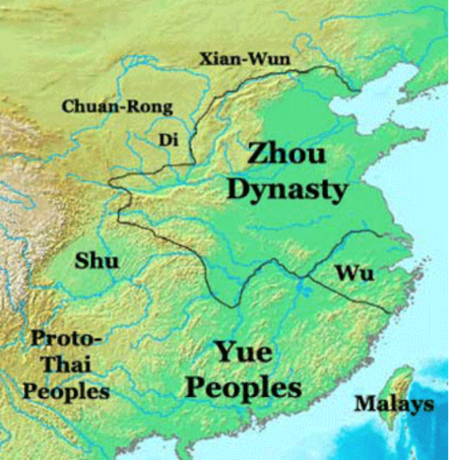
Servant Leadership: An Ancient Style with 21st Century Relevance
The concept Servant leadership dates back to ancient history.
Ancient monarchies practiced leadership which was in service of their people and country.
The constructs and teachings of servant leadership can be traced back to the Zhou dynasty and align with the teachings of Confucius and the leadership of ancient Arabic cultures.
(Sendjaya & Sarros, 2002; Winston and Ryan, 2008; Hirschy, Gomez, Patterson, & Winston, 2012).)
Notes:
sl

Slide 5
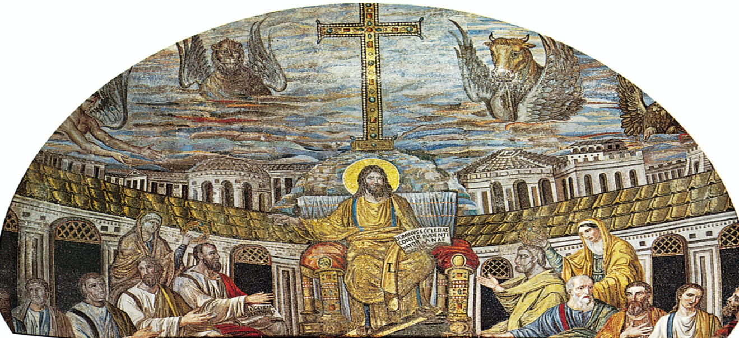
Servant Leadership and Christianity
The term “servant leader” has been used for centuries and is accredited to the ancient teachings of Jesus and Christianity. (Gandolfi and Stone, 2017).
Sendjaya and Sarros (2002) suggest that Jesus was the first to introduce the concept of leadership as it connects with being of service to others.
Notes:
Consider removing

Slide 6
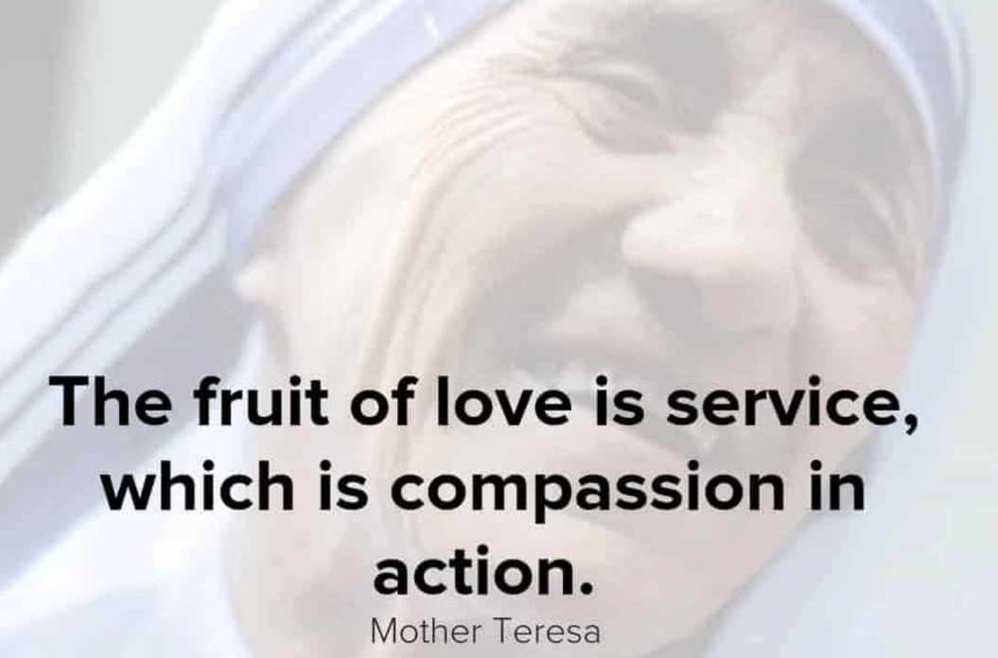
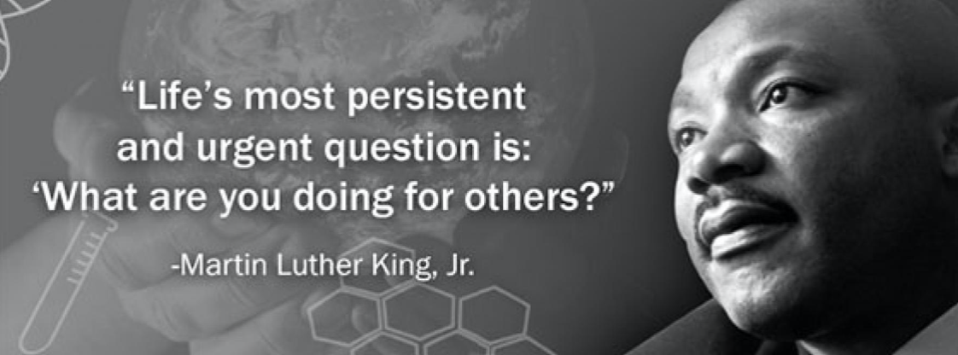
In more recent history, Mother Teresa and Martin Luther King Jr. serve as examples of leaders who demonstrate servant leadership.
(Gandolfi and Stone, 2017).

Slide 7
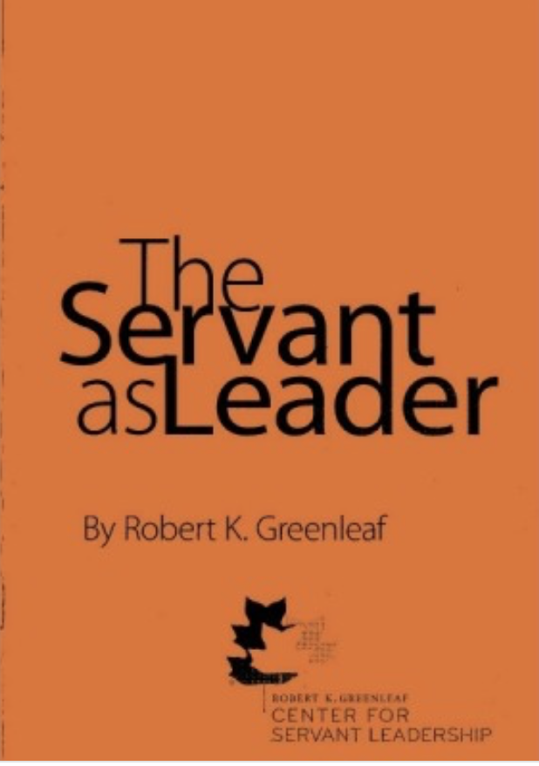
Greenleaf Coins the Term Servant Leadership
While servant leadership has been in existence since ancient times, the modern version of the phrase “servant leadership” was coined by Robert K. Greenleaf in The Servant as Leader, an essay that Greenleaf first published in 1970.

Slide 8
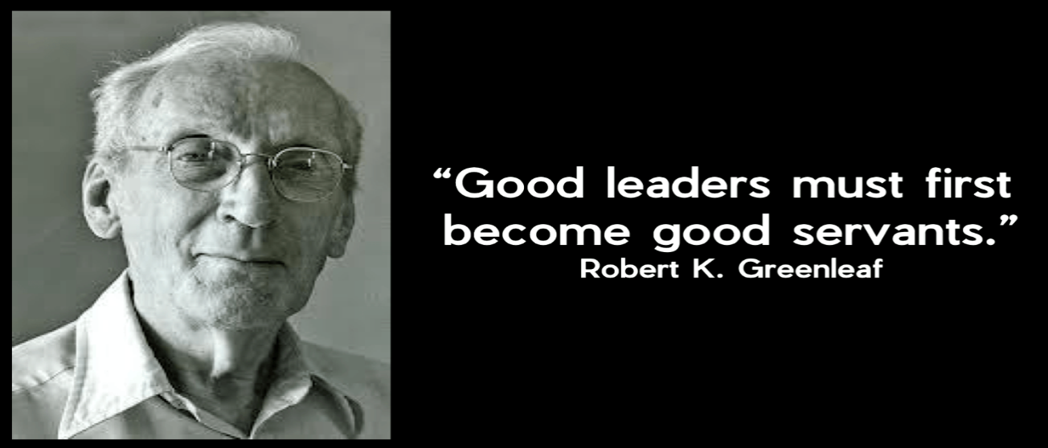
In that revolutionary, powerful and poetic essay that started it all:
The Servant as Leader, Greenleaf (1970) said:
The servant-leader is servant first… It begins with the natural feeling that one wants to serve, to serve first. Then conscious choice brings one to aspire to lead. That person is sharply different from one who is leader first, perhaps because of the need to assuage an unusual power drive or to acquire material possessions (p. 6).

Slide 9
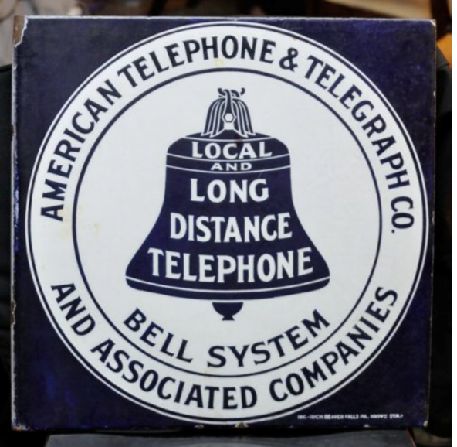

From serving as a management consultant and visiting scores of thriving companies as well as those on the brink of dissolving, Greenleaf realized that successful organizations had supportive leaders who acted as coaches and considered the needs of the employee as well as the company.
“The organization exists for the person as much as the person exists for the organization” (Greenleaf as cited in Frick, 2016, para. 3).
Notes:
Consider removing

Slide 10
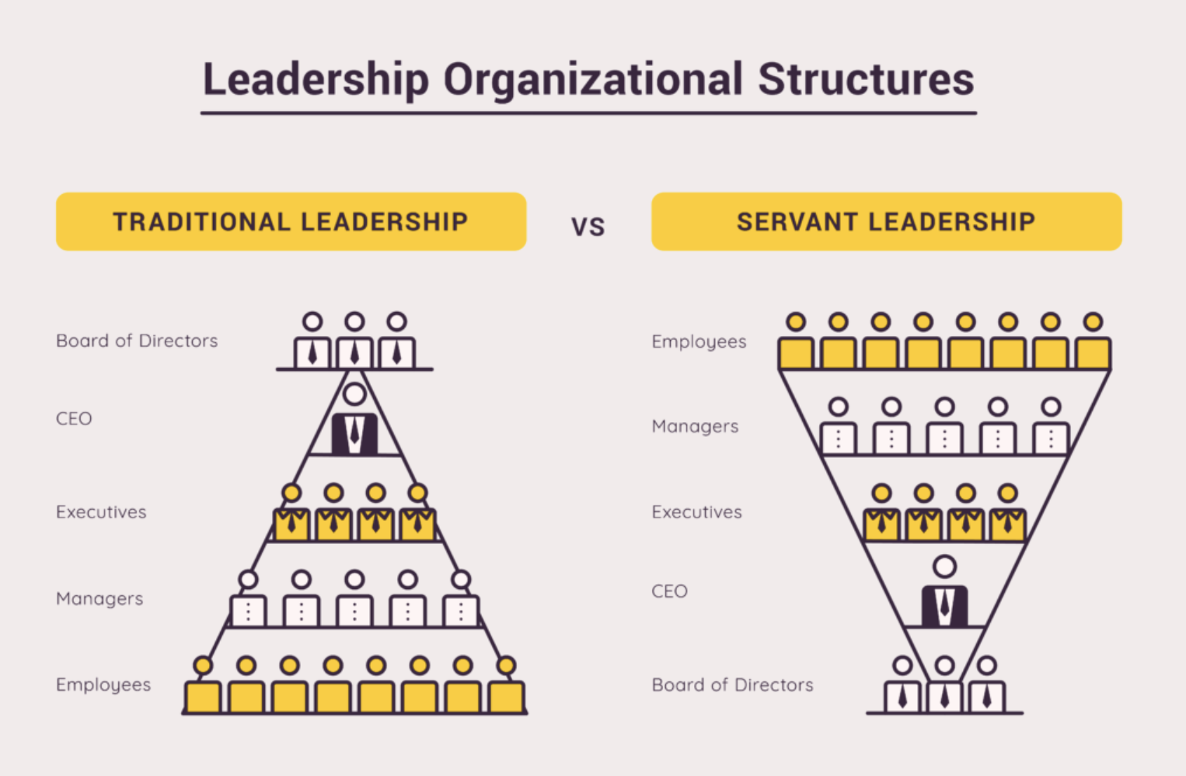

Slide 11
